Slide 1
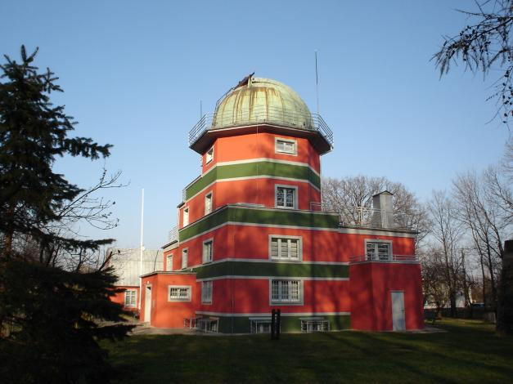
TRACE and RHESSI observations
of the failed eruption of
the magnetic flux rope
Tomasz Mrozek
Astronomical Institute
University of Wrocław

Slide 2
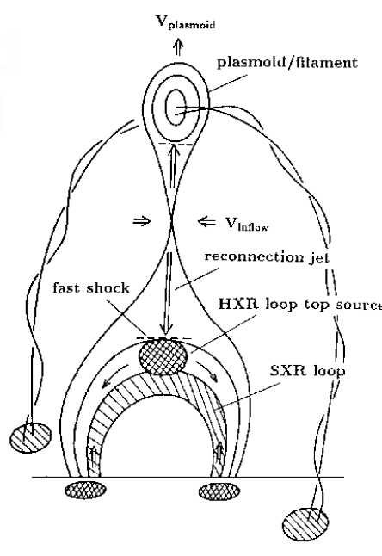
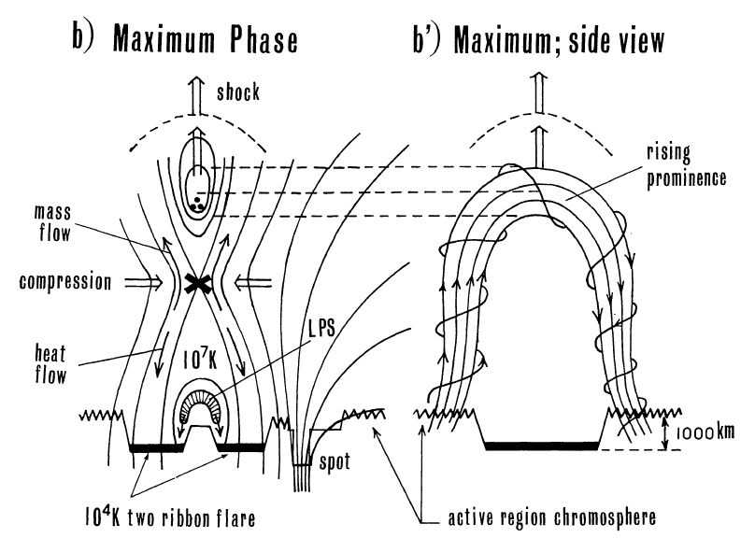
CSHKP („standard”) model
Hirayama 1974
bipolar configuration is destabilized->
raising filament drags arcade field lines ->
magnetic reconnection occurs below
the filament ->
the reclosed arcade and the flying blob are
the products of this scenario
Shibata et al., 1995

Slide 3
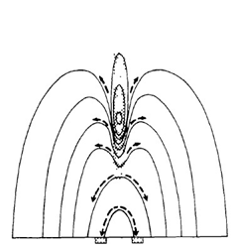
„standard” model
Hyder, C. L. 1967
Basic problems:
- the dark filament exists due to
sagging of the field lines at the tops
of the convex arcade - very strong
assumption
Shibata et al., 1995

Slide 4
„standard” model
Hirayama 1974
Basic problems:
- the kinetic energy of the raising filament should be larger than the
energy of the flare itself. Thus, in
this model, the flare is only the
repairing process of a more energetic
break-up caused by the rising filament.
Shibata et al., 1995

Slide 5
„standard” model
Hirayama 1974
Basic problems:
- observations show (Leroy et al. 1983) that the direction of magnetic field perpendicular to the filament is opposite to the direction expected from the simple connection of the bipolar filed below
Shibata et al., 1995

Slide 6
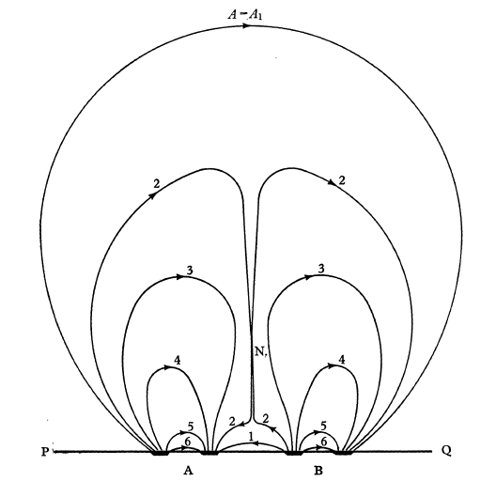
quadrupolar model
50 (!) years ago Sweet suggested that flares
may occur in the quadrupolar magnetic filed
configuration.
The quadrupolar model describes observed
features of solar flares in a more natural way.
For some reason the theoretical work has ignored this kind of complexity and try to develop the theory of simple, bipolar configuration – the „standard” model
Fortunately, the theory of Sweet has been
ressurected recently.
Sweet, P. A. 1958

Slide 7
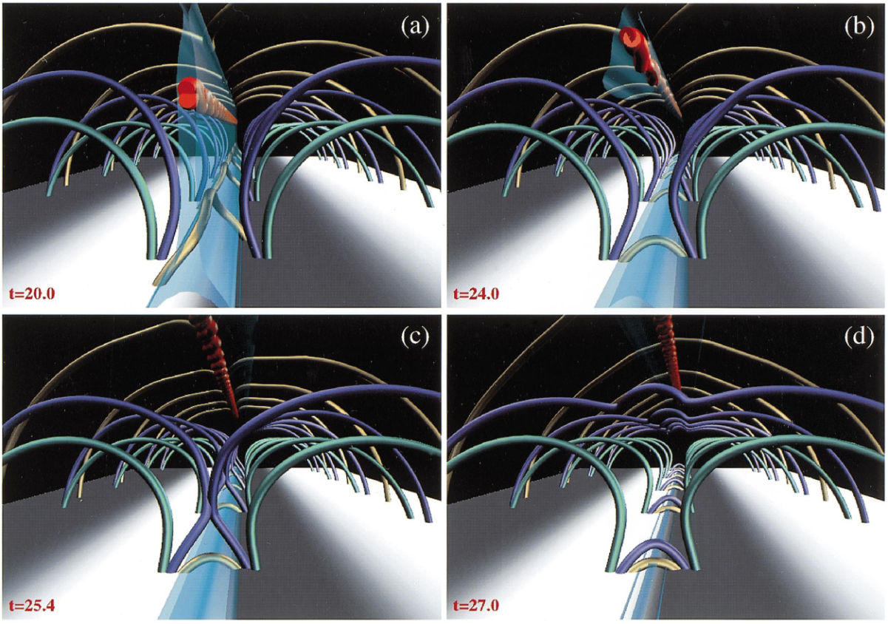
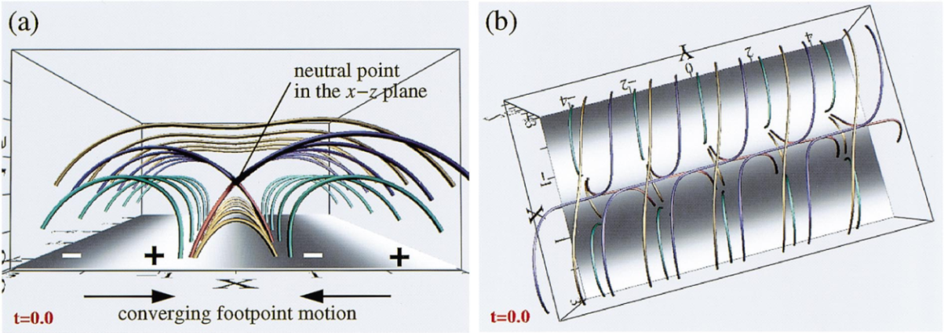
quadrupolar model
In this model the existence of the dark
filament is obvious. Moreover, it easily
explains the observed very thin vertical
structure of the filament
The energy is built up in the system
before the dark filament eruption
The dark filament is accelerated upward,
and in the lower region recconnected
field lines shrink to form magnetic
arcade
A quotation from Hirose et al. (2001):
In this simulation (…) the upward motion
of the dark filament (…) may eventually
be arrested by the overlying closed field.
Uchida et al. 1999
Hirose et al. 2001

Slide 8
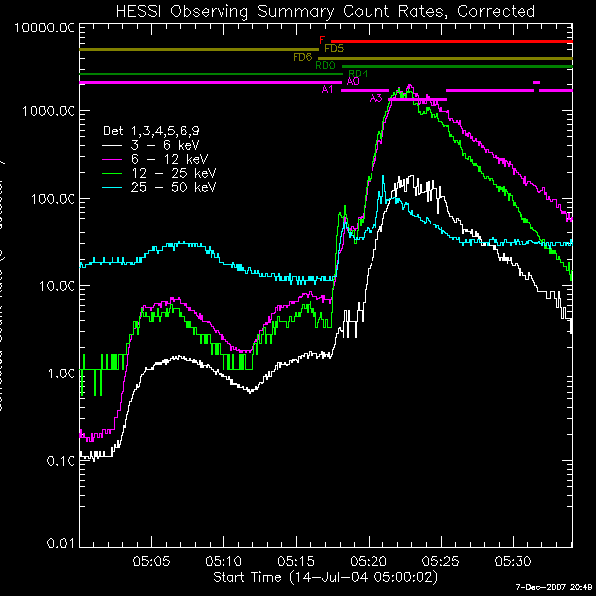
the flare
July 14th, 2004
M6.2 GOES class
N14 W61
Observations
RHESSI: entire event
TRACE: 171 Å (several seconds
cadence)

Slide 9
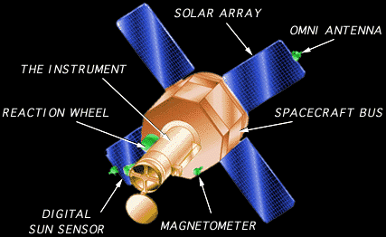
observatories
TRACE (1998)
30 cm Cassegrain telescope giving 1 arcsec
spatial resolution
The observations are made in the EUV (transition
region, colonal loops) and UV (chromosphere)
ranges. Moreover, white-light images are made
RHESSI (2002)
9 large, germanium detectors
observations are made in the range
from 3 keV to 17 Mev with high
energy resolution
spatial resolution is up to 2.5 arc sec

Slide 10
the flare
Relatively strong flare is connected with
small magnetic arcade (less than 10⁴km).
Several episodes were observed:
- brightenings before the flare
eruption which was started during the impulsive phase
deceleration of the eruption and side eruptions
radial oscillations of the system of loops observed high in the corona

Slide 11
preflare activity
Preflare brightenings were observed
between 5:03 and 5:17 UT.
In the TRACE images we observed
brightenings in small systems of loops
There is enough signal for reconstructing
RHESSI images with detector 1 giving
the highest spatial resolution (about 2.5
arc sec)

Slide 12
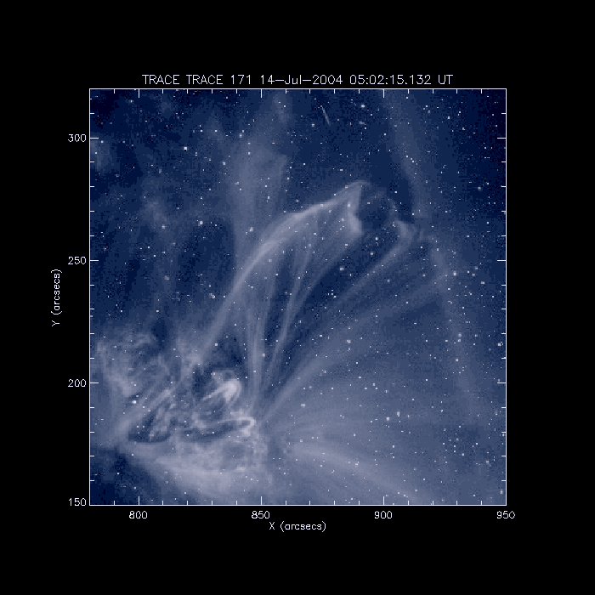
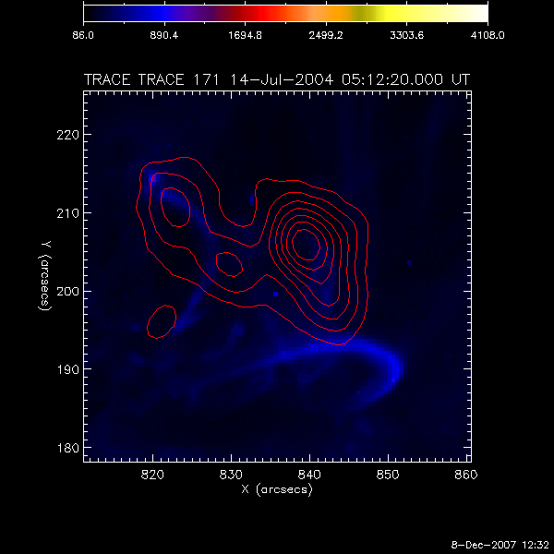
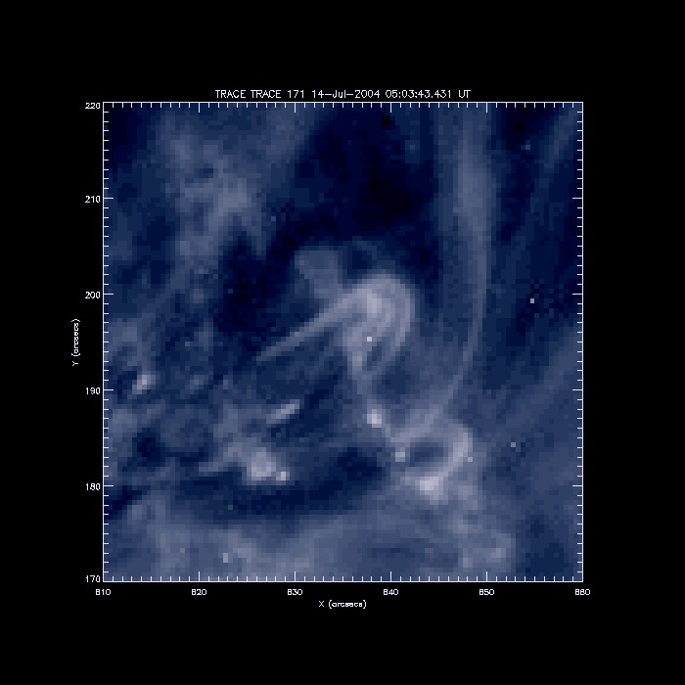
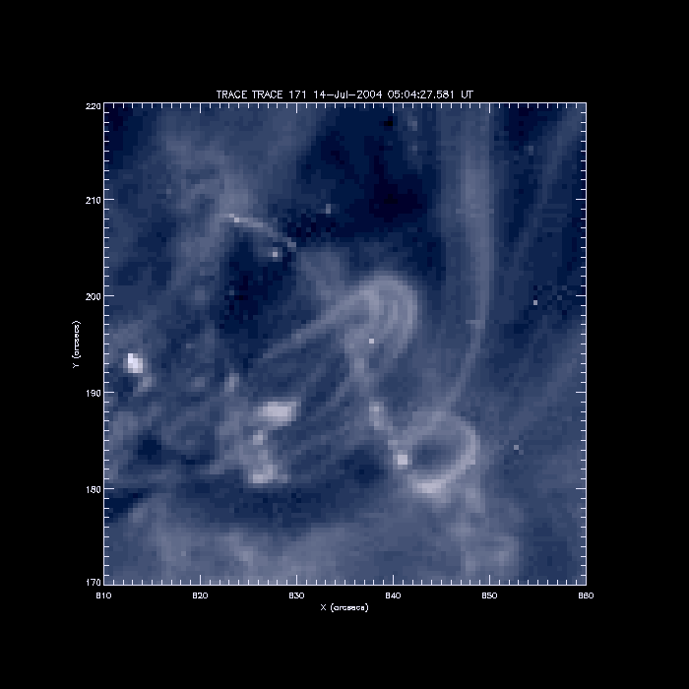
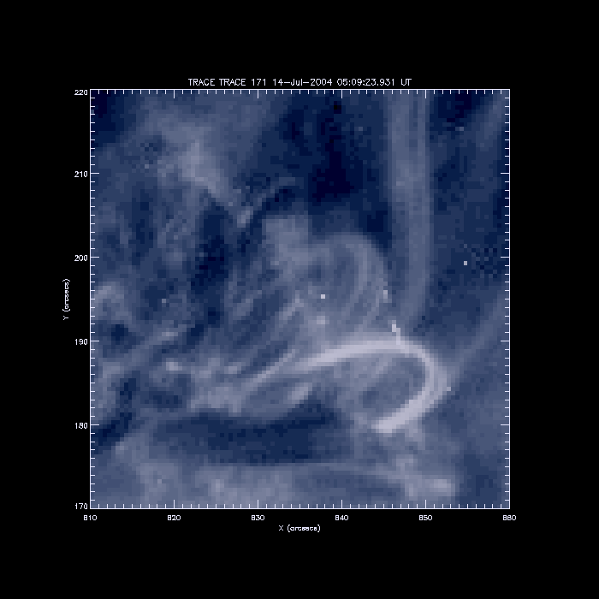
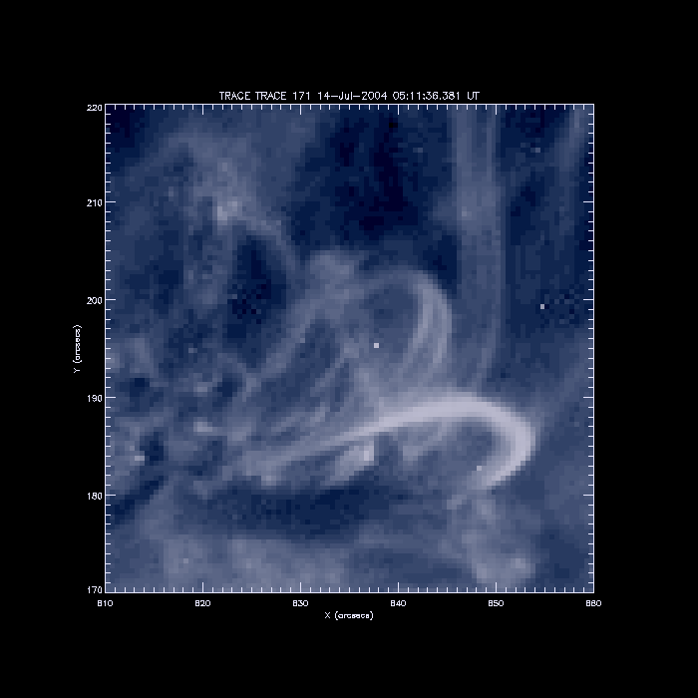
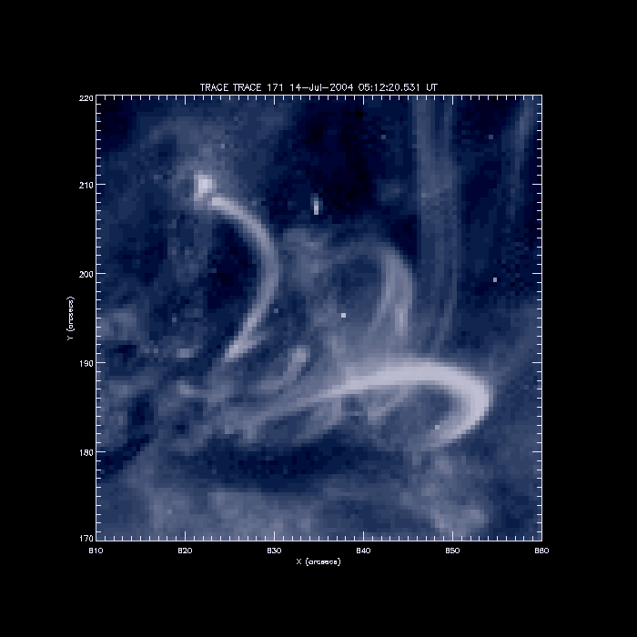
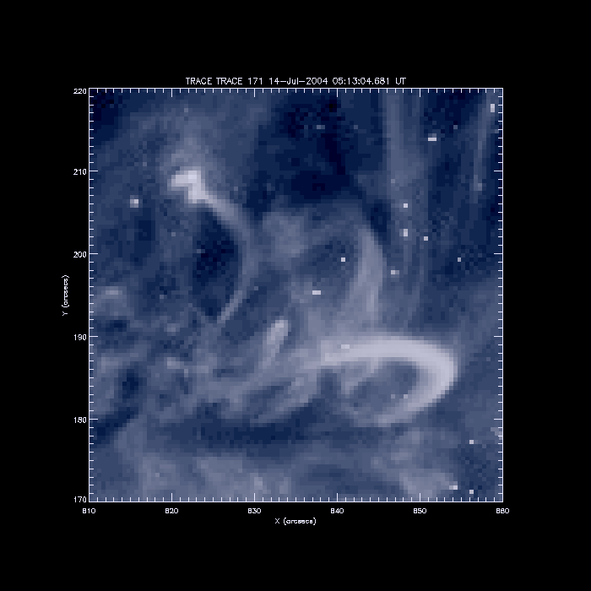
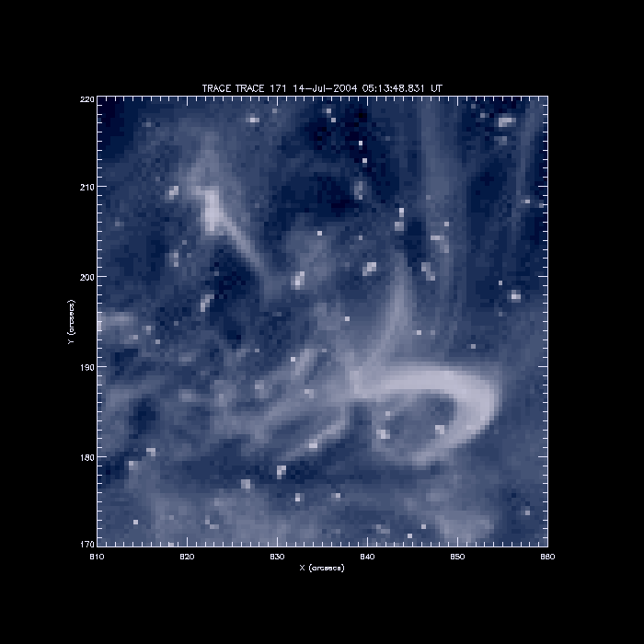
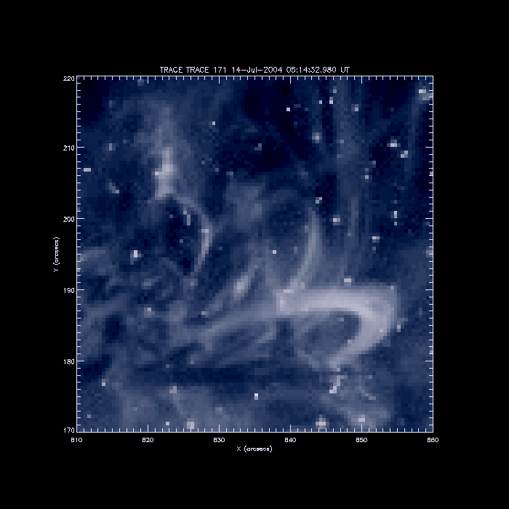
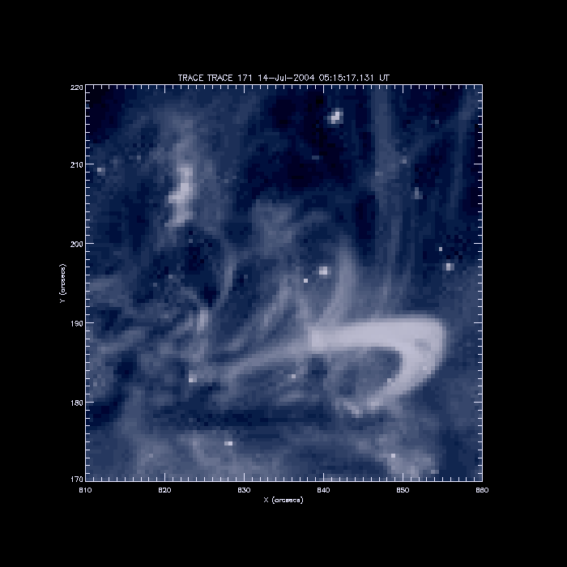
preflare activity
Contours – RHESSI sources
observed in the range 8-16 keV

Slide 13
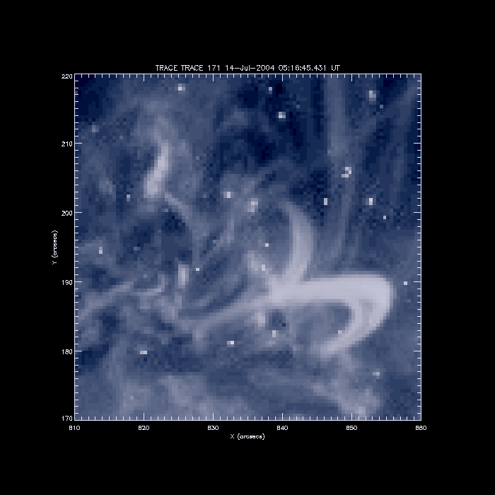
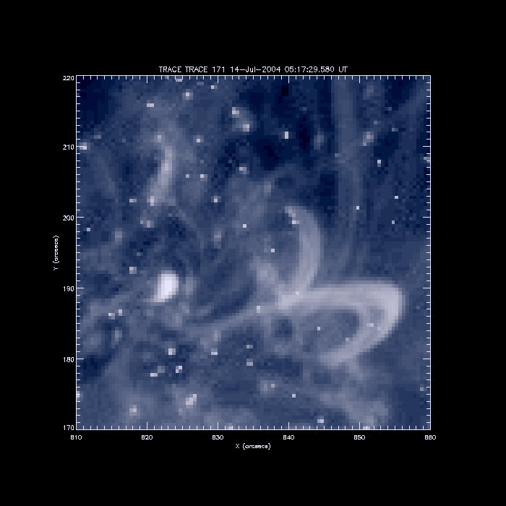
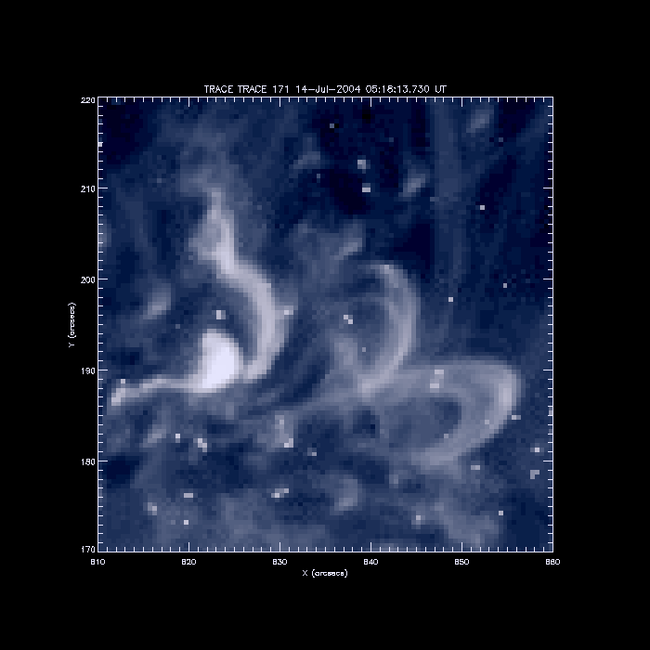
the beginnig of the impulsive phase
Abrupt brightening connected with the flare is visible on
the TRACE image obtained on 5:17:30 UT
The eruption of the magnetic flux tube is observed
several seconds after
The eruption started in a very compact region (about
3000 km in diameter!)

Slide 14
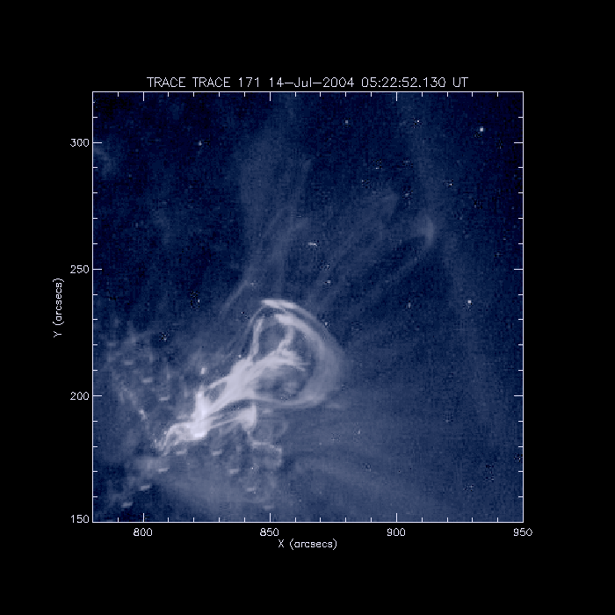
the eruption
The height of the erupting structure
was calculated along the yellow line.
On each TRACE image the distance
between the front of the eruption
and the reference line was calculated

Slide 15
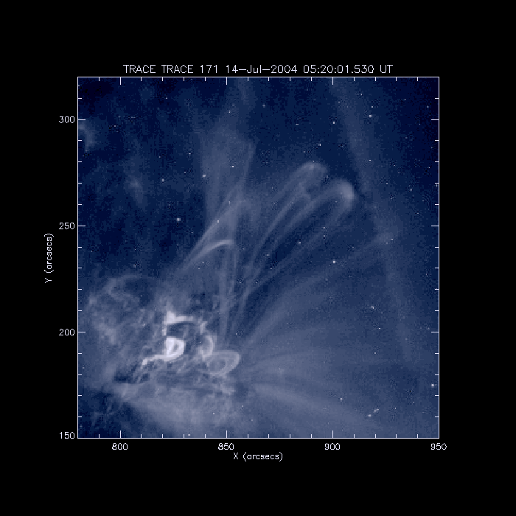
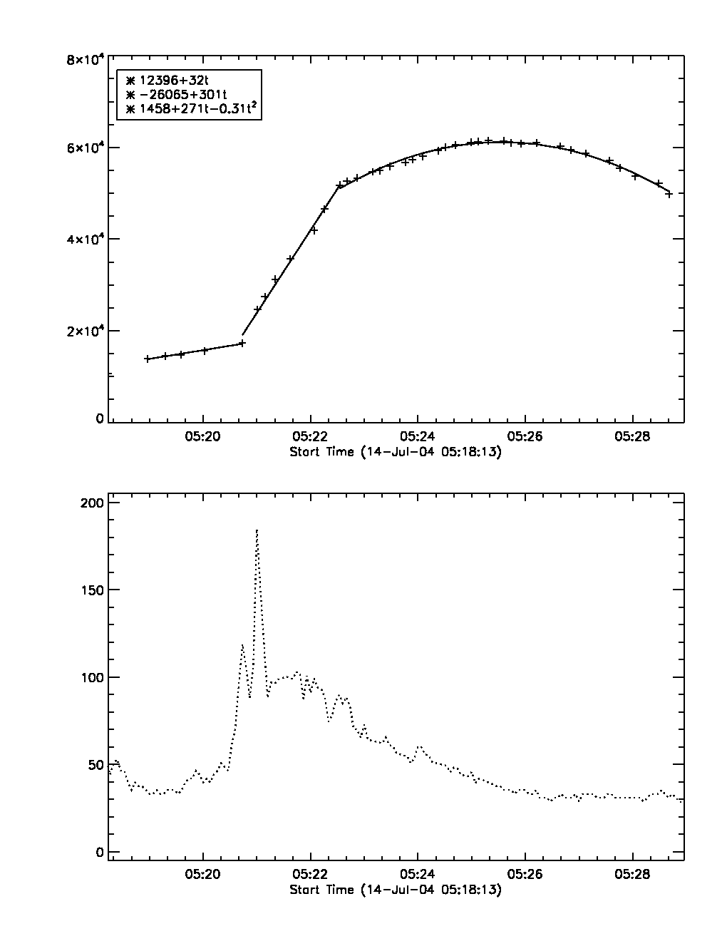
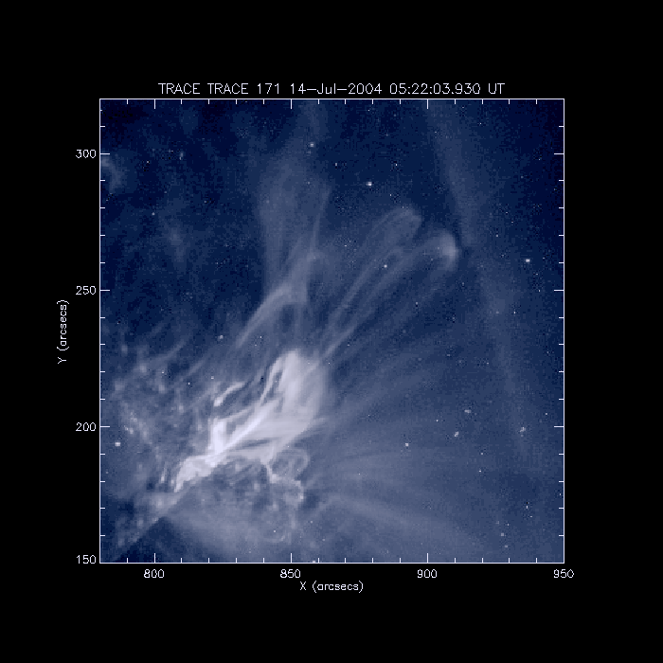
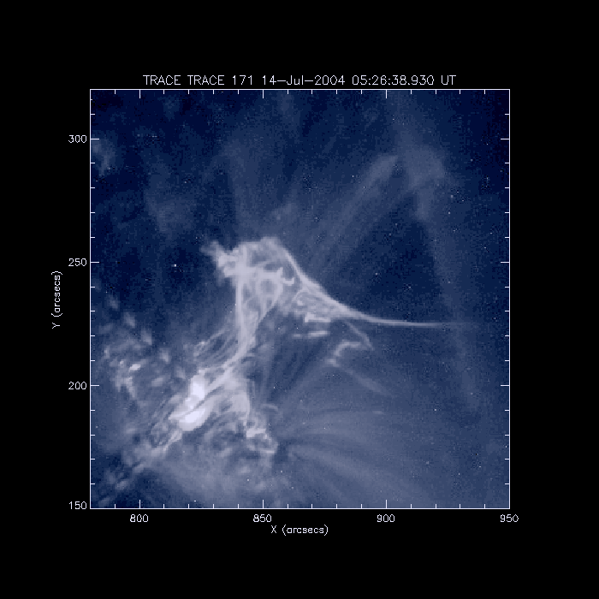
evolution of the eruption
Initial phase ,
the eruption
moves with
small, constant
velocity
3
H[km]
2
1
Fast evolution
following the
strongest HXR
peak visible
in 25-50 keV
range
25-50 keV
Deceleration
phase. Main
front changes
its shape. Side
eruptions are
observed

Slide 16
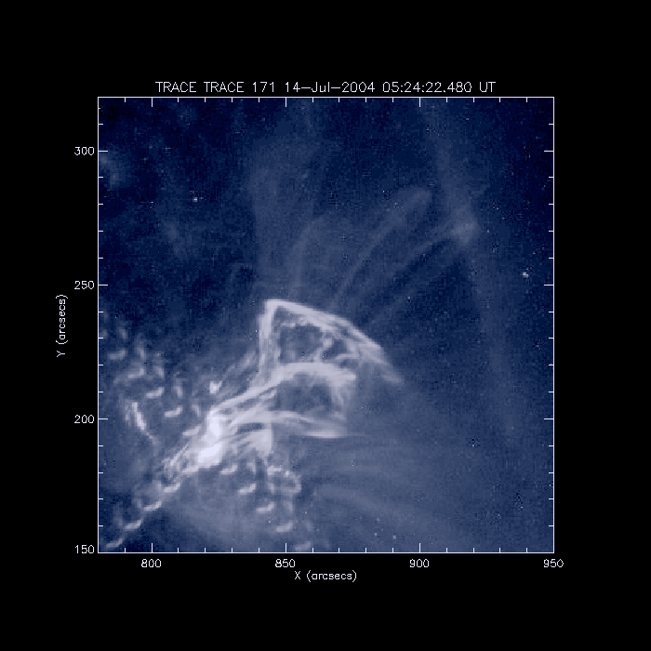
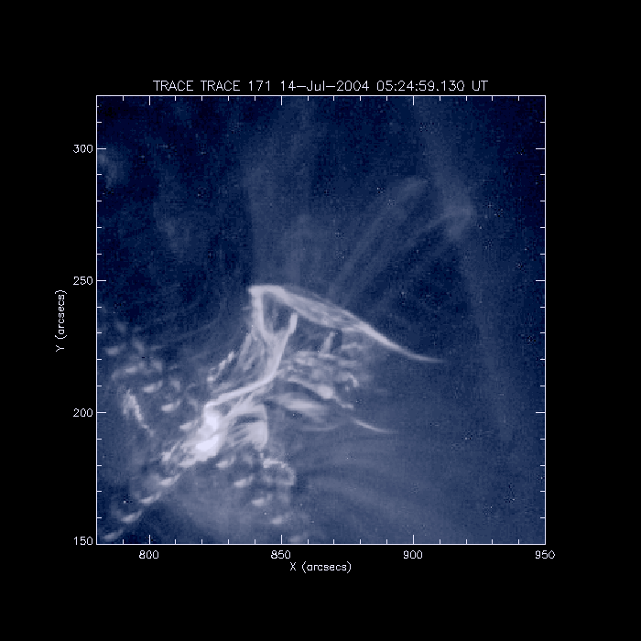
interaction with low-lying loops
The deceleration value (about 600 m/s²) and the shape of the eruption front show that „something”stopped it. It is possible that two systems of loops were involved in braking the eruption.
Brightenings observed during the deceleration of the main front.

Slide 17
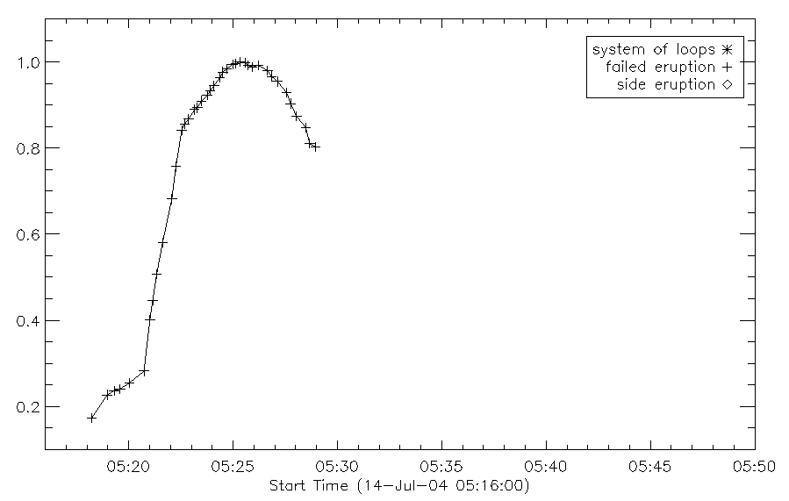
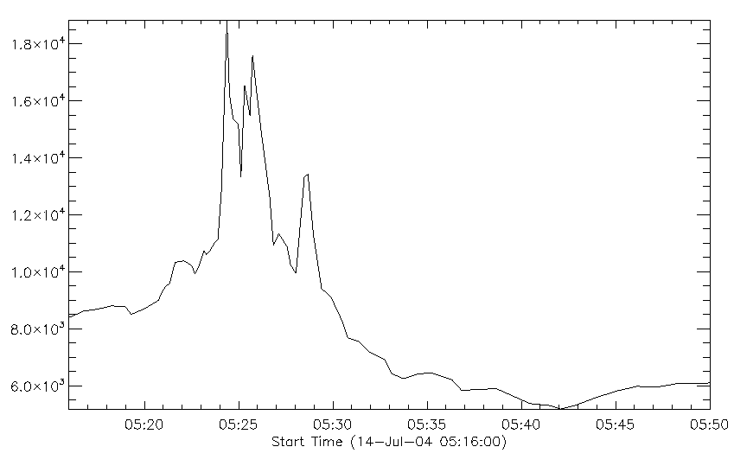
interaction with low-lying loops
Brightenings in the region marked with
the red box suggest the interaction
between the eruption and surrounding
magnetic structures

Slide 18
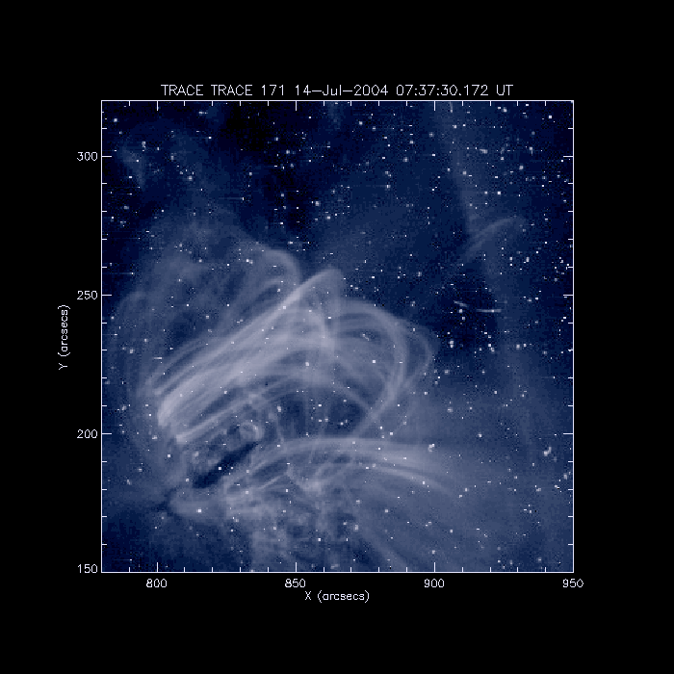
interaction with low-lying loops
The shape of the eruption suggests that there is a low-lying (but still above the flare) system
of loops existing during the impulsive phase. Moreover, there are brightenings observed in
the same location where low-lying system of loops is anchored. Possibly the loops where
heated due to interaction with the eruption – they are not „post-flare loops” within
the meaning of the standard model

Slide 19
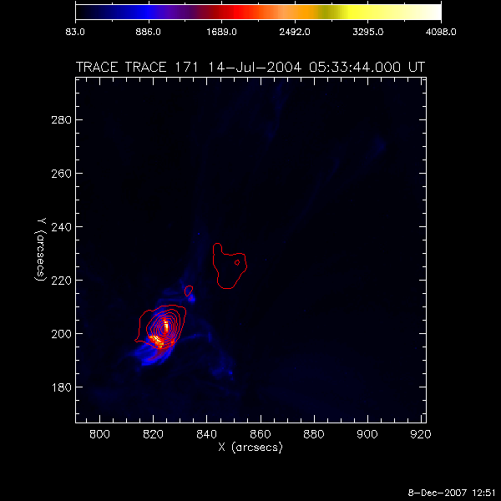
interaction with low-lying loops
We observed the 8-16 keV source located in the region of possible interaction between
the eruption and the low-lying loops

Slide 20
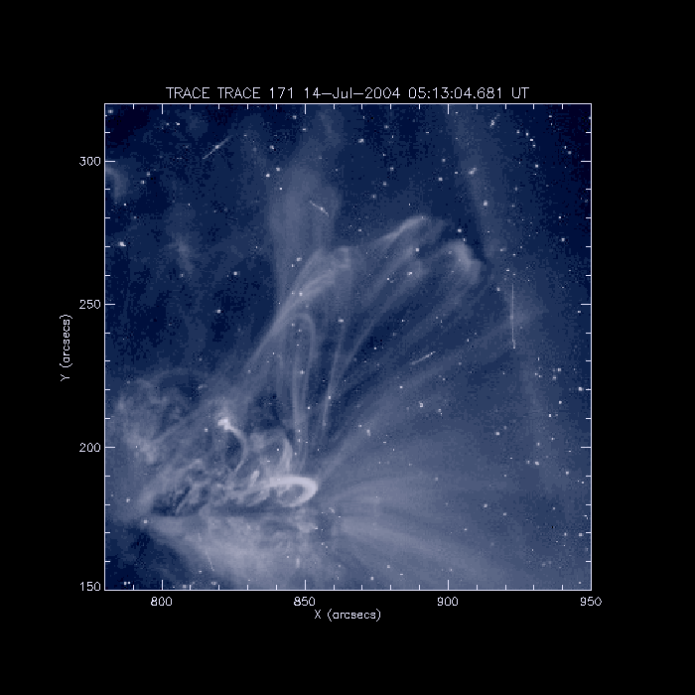
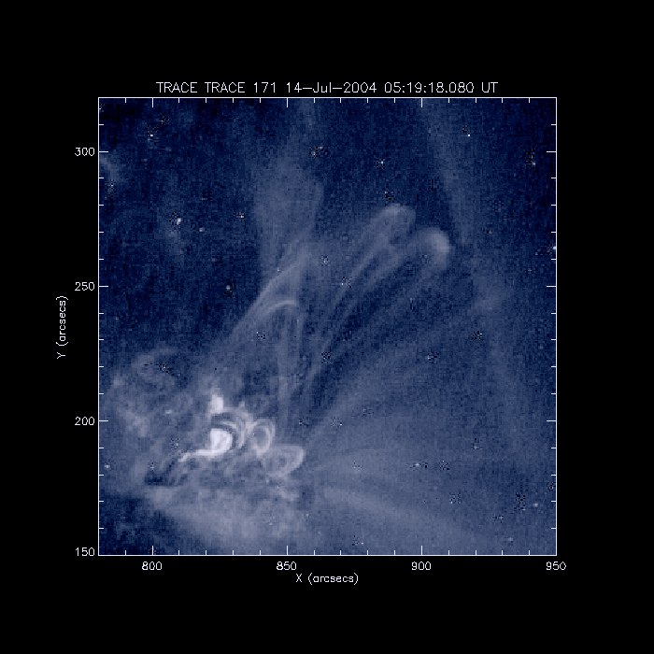
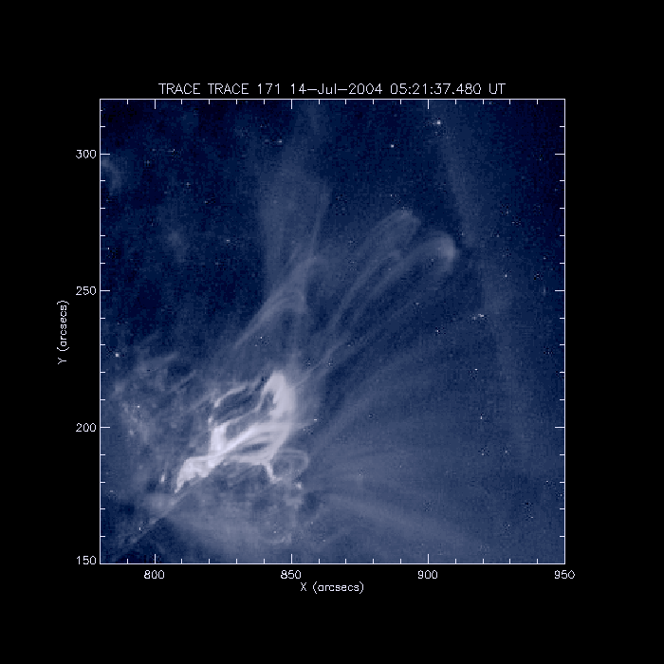
interaction with high-lying loops
Above the erupting
structure we observed
the system of high-lying
loops.
These loops changed
their height as the
eruption evolved.

Slide 21
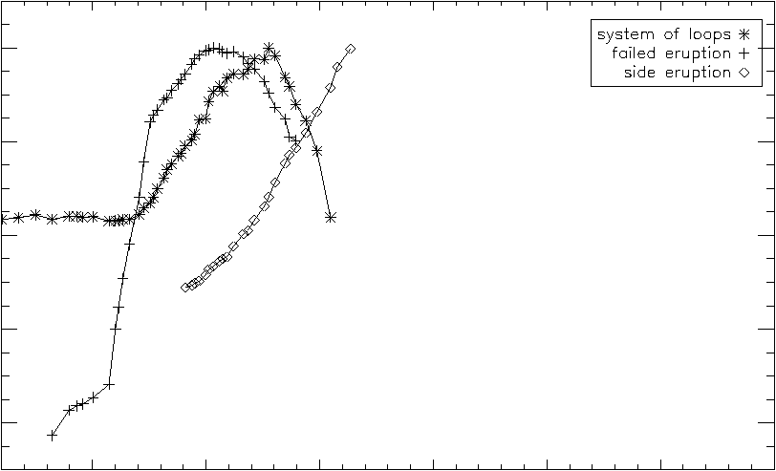
interaction with high-lying loops
The end of the foremost eruption
(and the end of the force driving the
movement of the high-lying loops)
The beginning of the northern eruption
High-lying loops started to rise

Slide 22
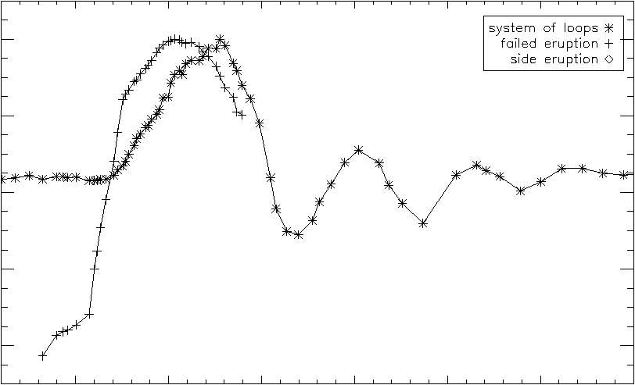
the evolution of the high-lying loops
the end of the force driving the
movement of the high-lying loops
loops started to move back

Slide 23
global oscillations of coronal loops
Radial, transversal
Change of radius
One observation (Wang & Solanki 2004)
Tangential, horizontal
No change of radius
About 20 observations reported by several authors
We observed radial oscillations of coronal loops – very rare event. In our case we saw „the finger” that pulled loops – the magnetic structure ejected from below these loops

Slide 24
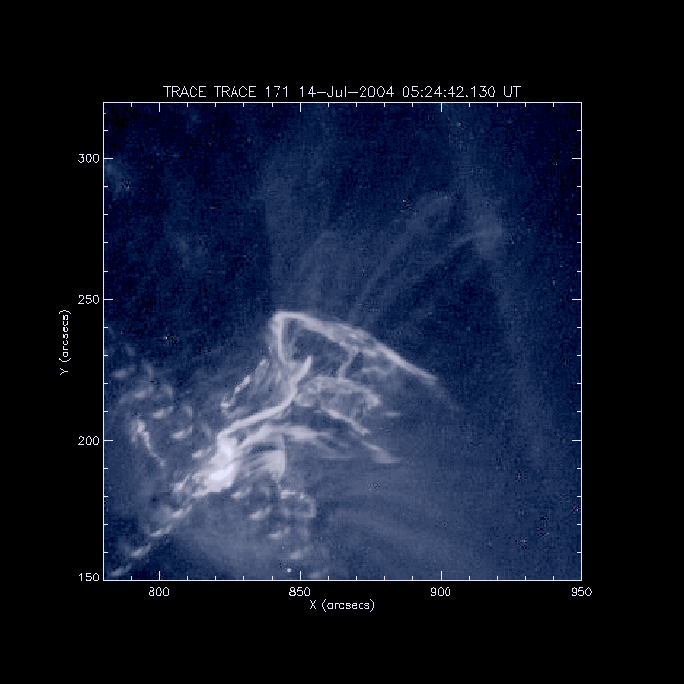
the evolution of the high-lying loops

Slide 25
summary
– small brightenings observed before the flare within the flaring structure √
– brightenings outside the flaring structure during the interaction between the eruption √
and surrounding loops
– deceleration of the eruption caused by the existence of surrounding system of loops √
– the eruption started in a very compact region, not in the large system of loops √

Slide 26
THANK YOU
FOR
YOUR ATTENTION

Slide 28
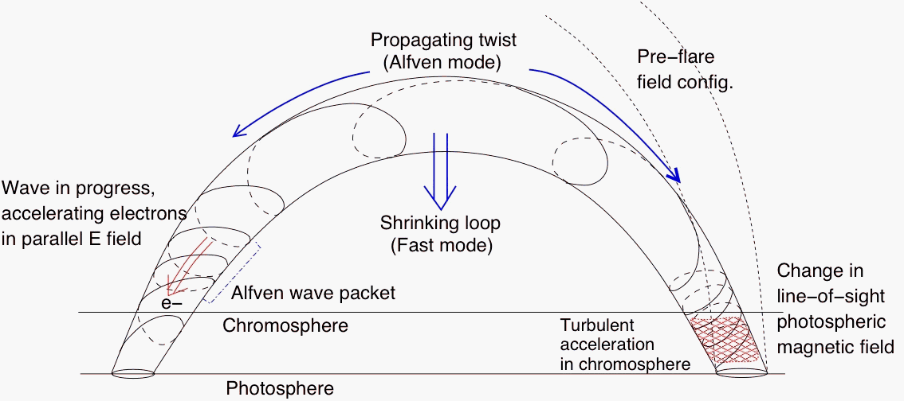
summary

