Slide 1
Obrazy prosto z nieba
Tomasz Mrozek
Instytut Astronomiczny UWr
Zakład Fizyki Słońca CBK PAN

Slide 2
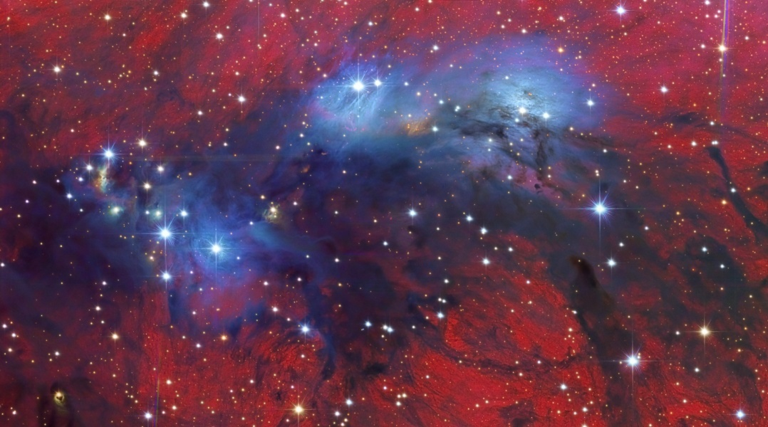
Zdjęcie czy wizja artysty?
Vicent Peris (OAUV), Jack Harvey (SSRO), Juan Conejero (PixInsight)
Notes:
A dramatic study in contrasts, this colorful skyscape features stars, dust, and glowing gas in NGC 6914. The complex of nebulae lies some 6,000 light-years away, toward the high-flying northern constellation Cygnus and the plane of our Milky Way Galaxy. With foreground dust clouds in silhouette, both reddish hydrogen emission nebulae and dusty blue reflection nebulae fill the 1/2 degree wide field. The view spans nearly 50 light-years at the estimated distance of NGC 6914. Ultraviolet radiation from the massive, hot, young stars of the extensive Cygnus OB2 association ionize the region's atomic hydrogen gas, producing the characteristic red glow as protons and electrons recombine. Embedded Cygnus OB2 stars also provide the blue starlight strongly reflected by the dusty clouds. Constructed as a two-panel mosaic, the image was processed to bring out both bright and dim colors and detailed structures.

Slide 3
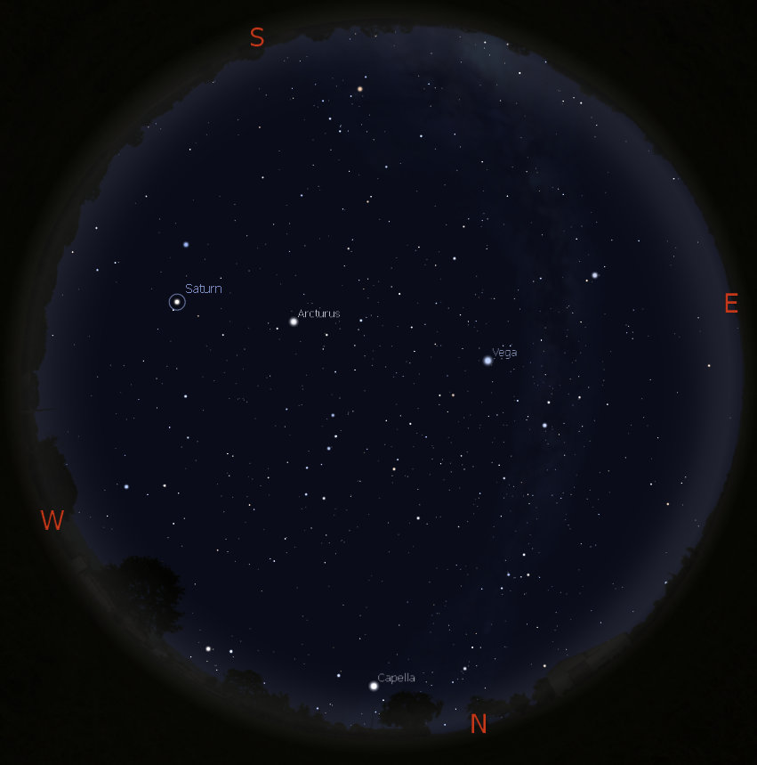
Co można zobaczyć na niebie?
Słońce
Księżyc
gwiazdy, gwiazdozbiory
planety
meteory
komety
sztuczne satelity
galaktyki
mgławice

Slide 4
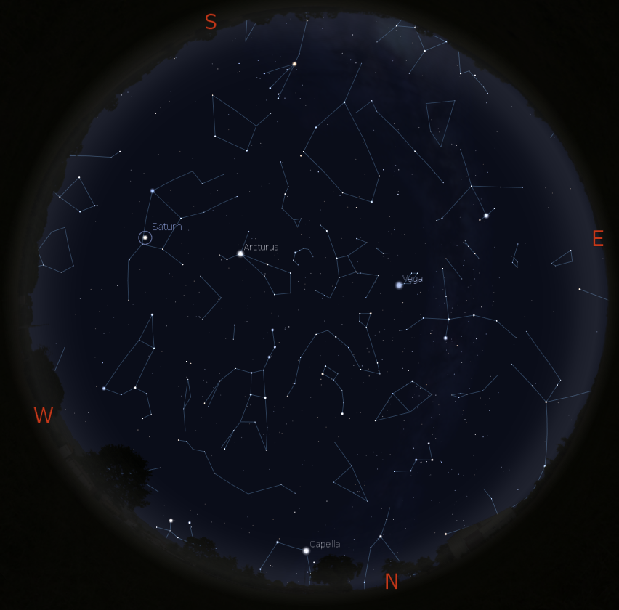
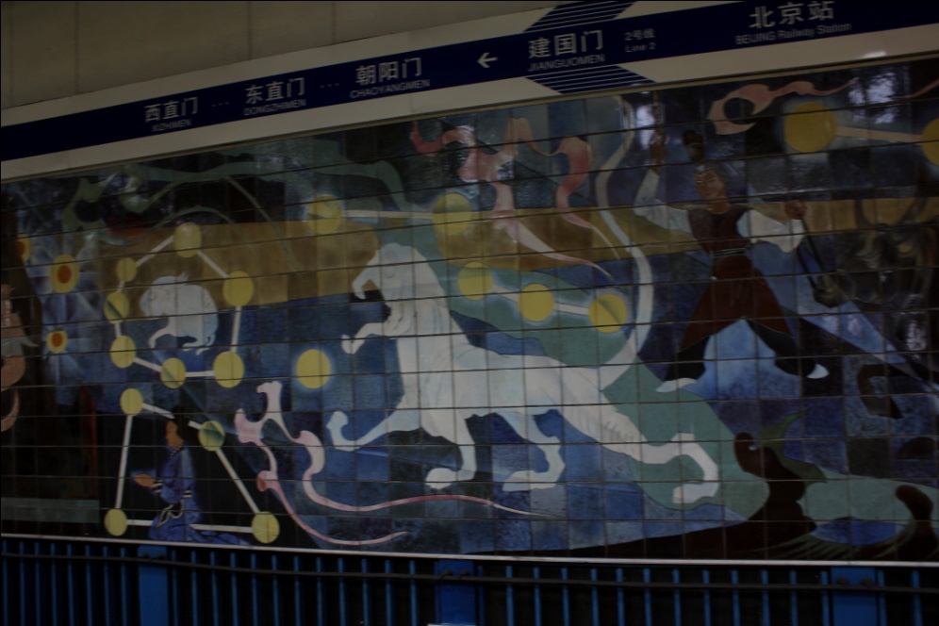
Na początku była wyobraźnia
Człowiek łączył kropki od
dawna

Slide 5
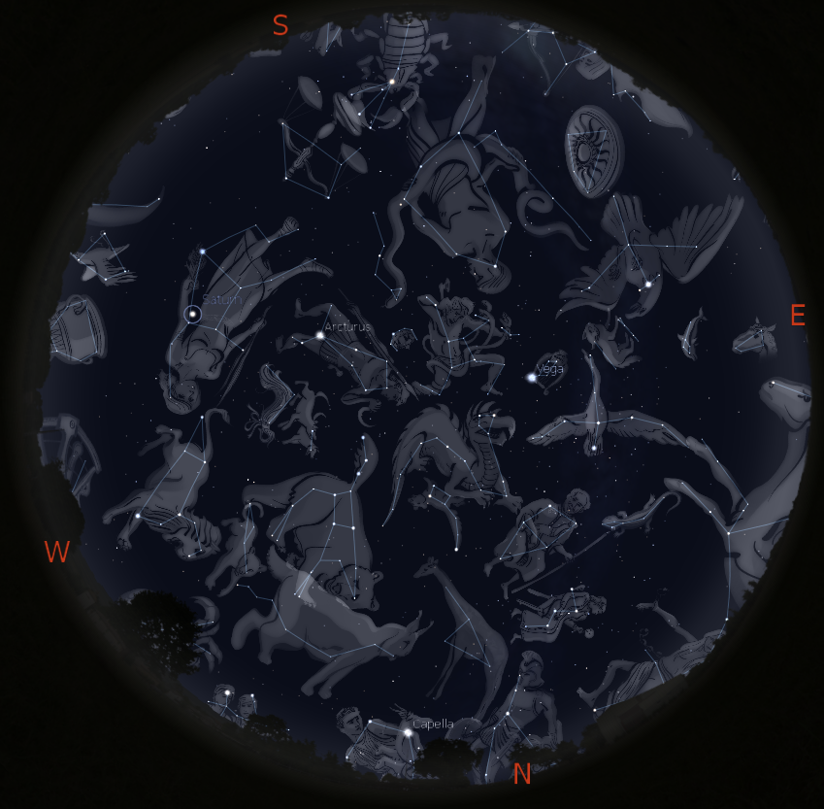
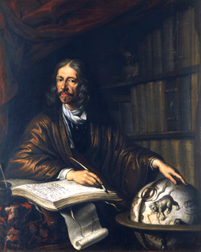
Na początku była wyobraźnia
Jan Heweliusz 1611 - 1687

Slide 6
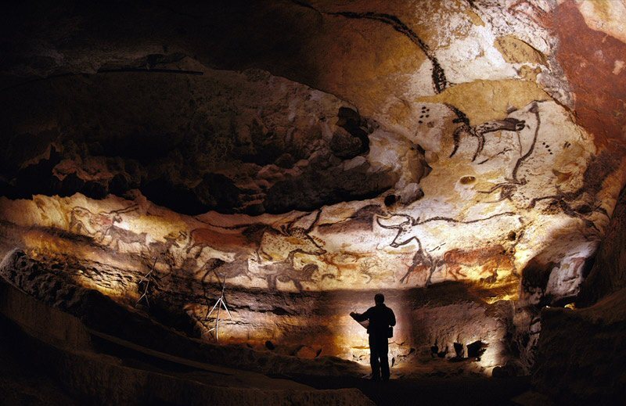
Pierwsze planetarium
Lascaux, 15000-13000 p.n.e.

Slide 7
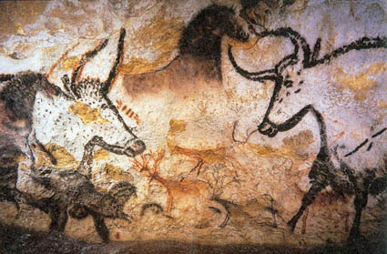
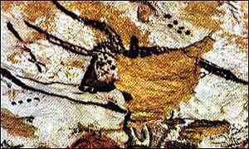
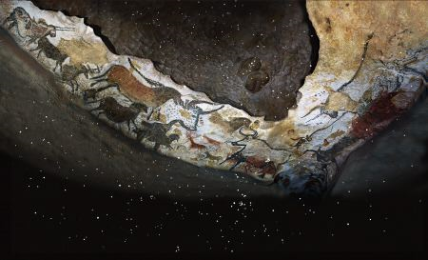
Pierwsze planetarium
Notes:
In recent years, new research has suggested that the Lascaux paintings may incorporate prehistoric star charts. Dr Michael Rappenglueck of the University of Munich argues that some of the non-figurative dot clusters and dots within some of the figurative images correlate with the constellations of Taurus, The Pleiades and the grouping known as the "Summer Triangle".^{[11]} Based on her own study of the astronomical significance of Bronze Age petroglyphs in the Vallée des Merveilles^{[12]} and her extensive survey of other prehistoric cave painting sites in the region — most of which appear to have been specifically selected because the interiors are illuminated by the setting sun on the day of the winter solstice — French researcher Chantal Jègues-Wolkiewiez has further proposed that the gallery of figurative images in the Great Hall represents an extensive star map and that key points on major figures in the group correspond to stars in the main constellations as they appeared in the Paleolithic.^{[13][14]}

Slide 8
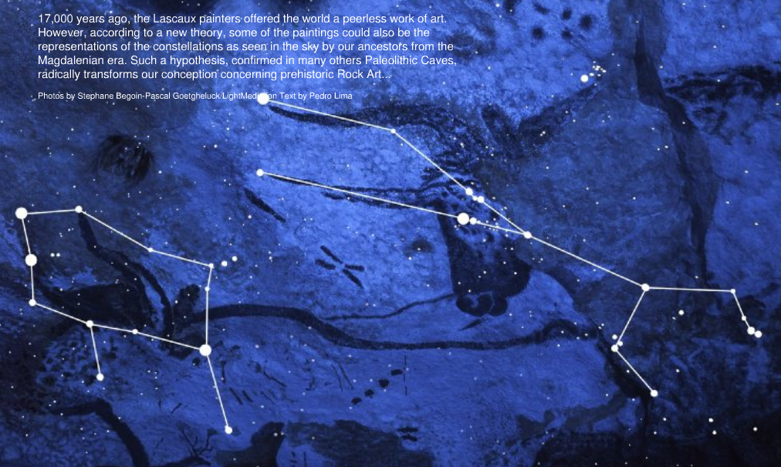
Pierwsze planetarium

Slide 9
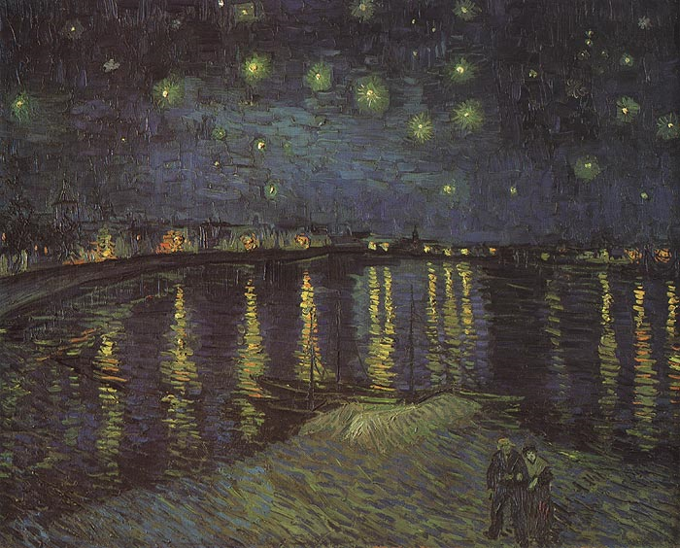
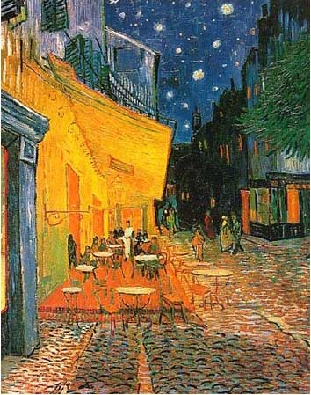
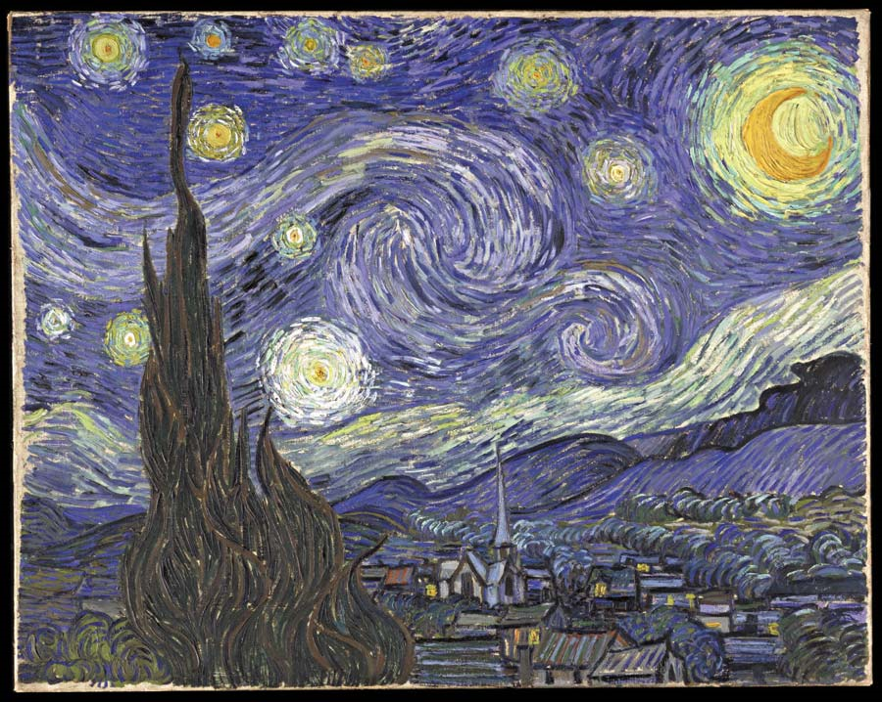
Van Gogh i gwiaździste niebo…
Nie o takich malarzach będzie mowa…

Slide 10
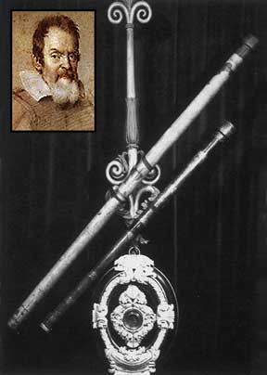
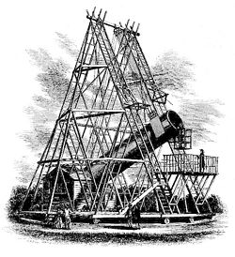
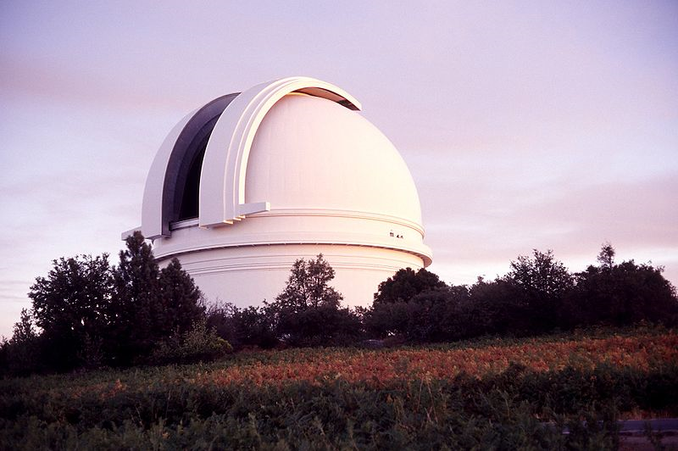
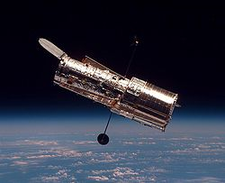
Pędzle malujące niebo
Obserwacje teleskopowe – od 1609 r.
Rejestracja fotograficzna – 1839 r.
Granica technologiczna refraktorów – 109 cm, Yerkes Obs.
Granica technologiczna reflektorów z monolitycznym
zwierciadłem głównym – 6m, BTA-6
Ogromne teleskopy – od 1993 r., teleskop Keck

Slide 11
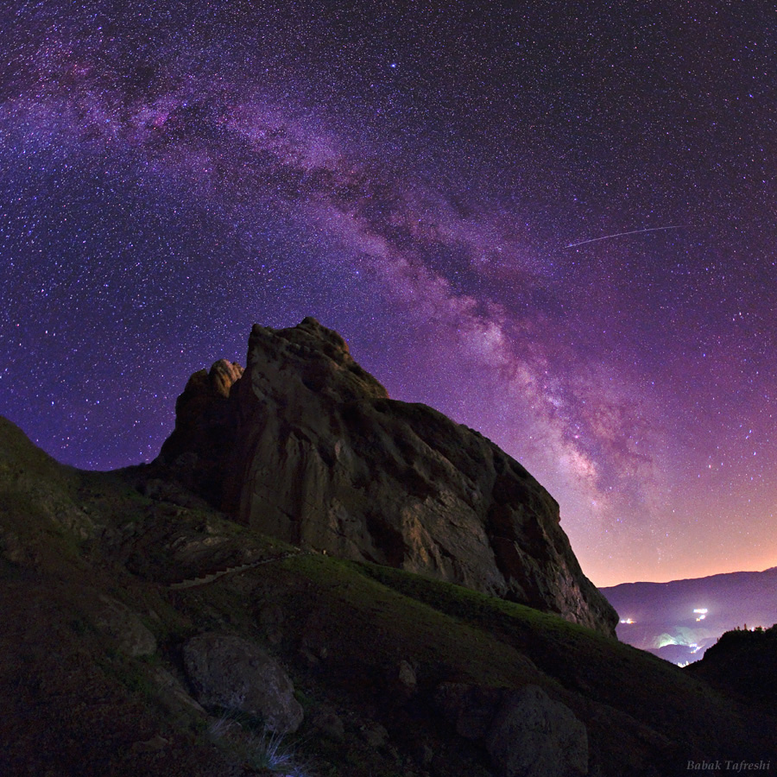
Ciemne niebo, piękne niebo
Babak Tafreshi (TWAN)
Notes:
The Starry Night of Alamut Image Credit & Copyright: Babak Tafreshi (TWAN) Explanation: A meteor's streak and the arc of the Milky Way hang over the imposing mountain fortress of Alamut in this starry scene. Found in the central Alborz Mountains of Iran, Alamut Castle was built into the rock in the 9th century. The name means Eagle's Nest. Home of the legendary Assassins featured in the adventure movie Prince of Persia, Alamut was also historically a center for libraries and education. For a time, it was the residence of important 13th century Persian scholar and astronomer Nasir al-Din al-Tusi. To identify the stars in a night sky Tusi certainly pondered, just slide your cursor over the image. Highlights include bright white stars Deneb (in Cygnus), Vega, and Altair, nebulae near the Galactic Center, and the dark obscuring dust clouds of the Milky Way also known as the Great Rift. Lights at the lower right are from small villages and the capital Tehran, over 100 kilometers away to the southwest.

Slide 12
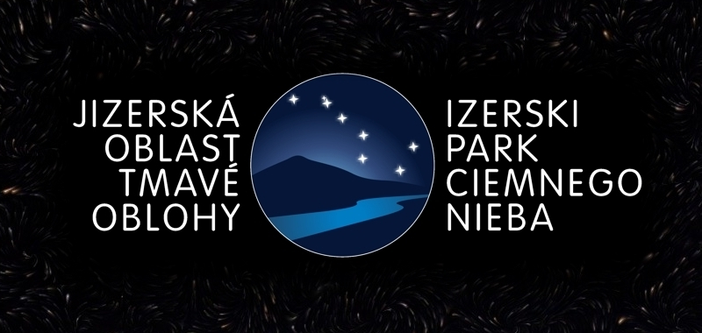
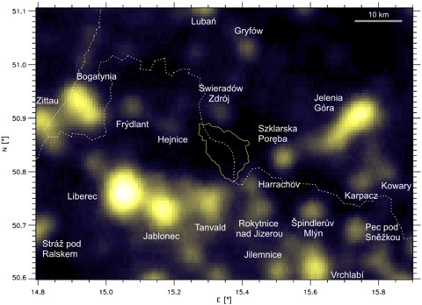
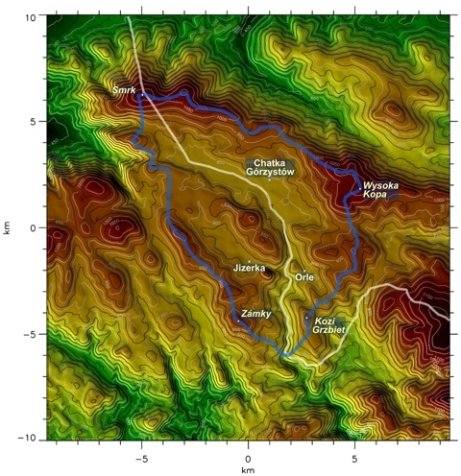
Ciemne niebo, piękne niebo
Inauguracja 4.11.2009 r.

Slide 13
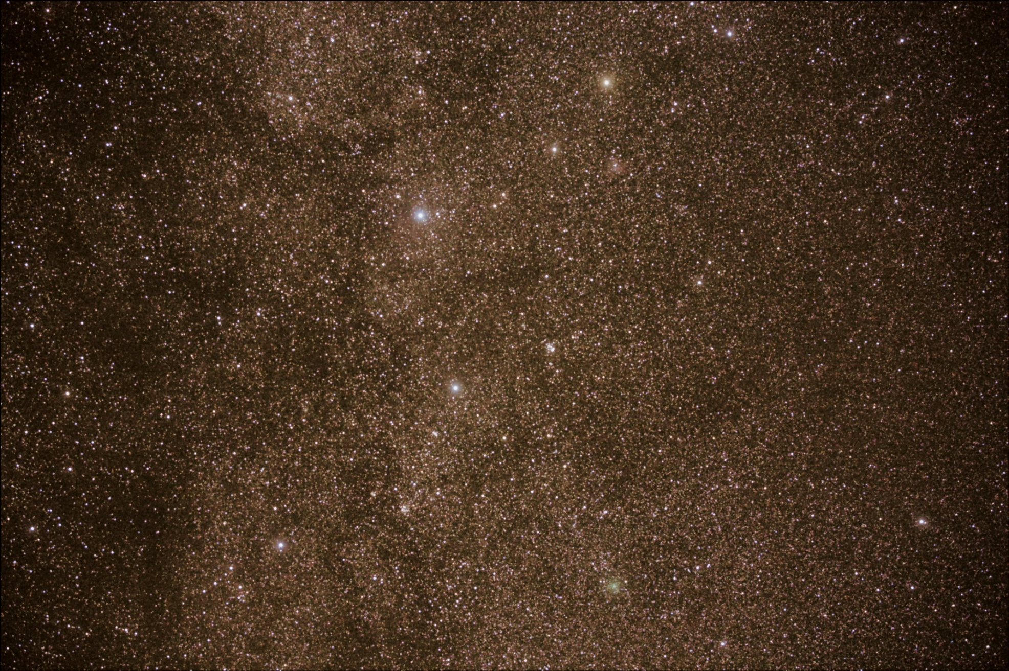
Ciemne niebo, piękne niebo

Slide 14
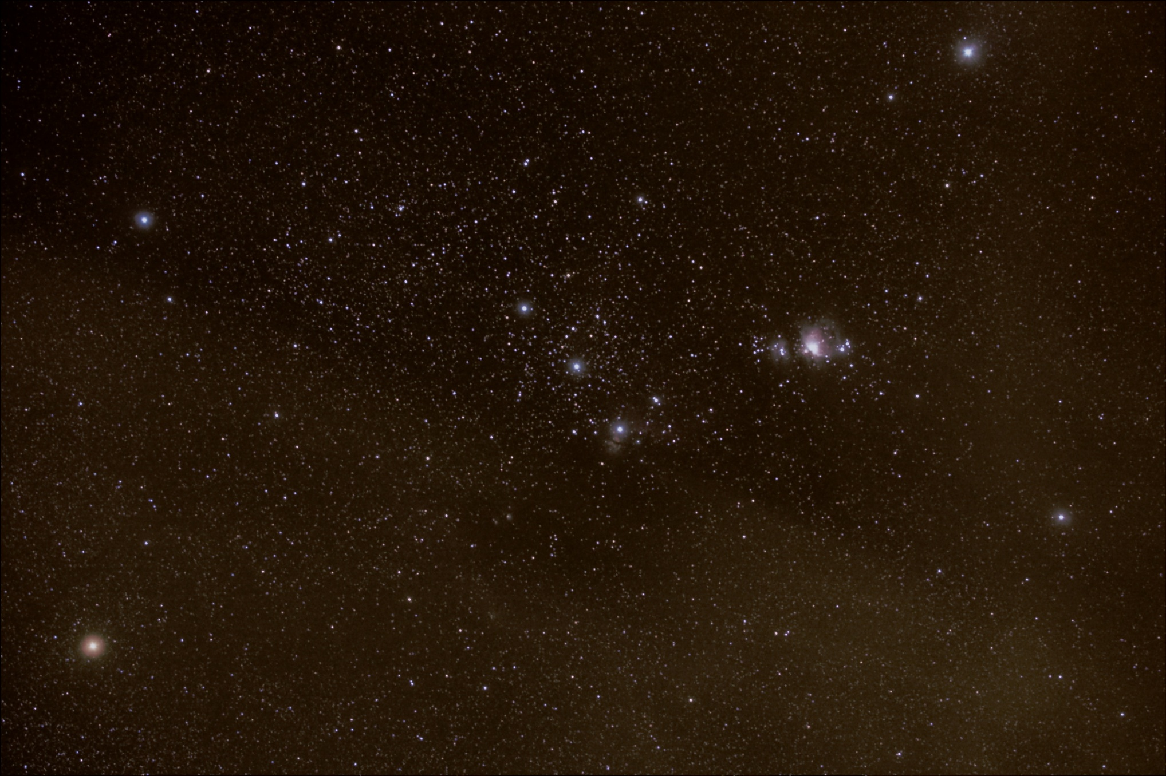
M42

Slide 15
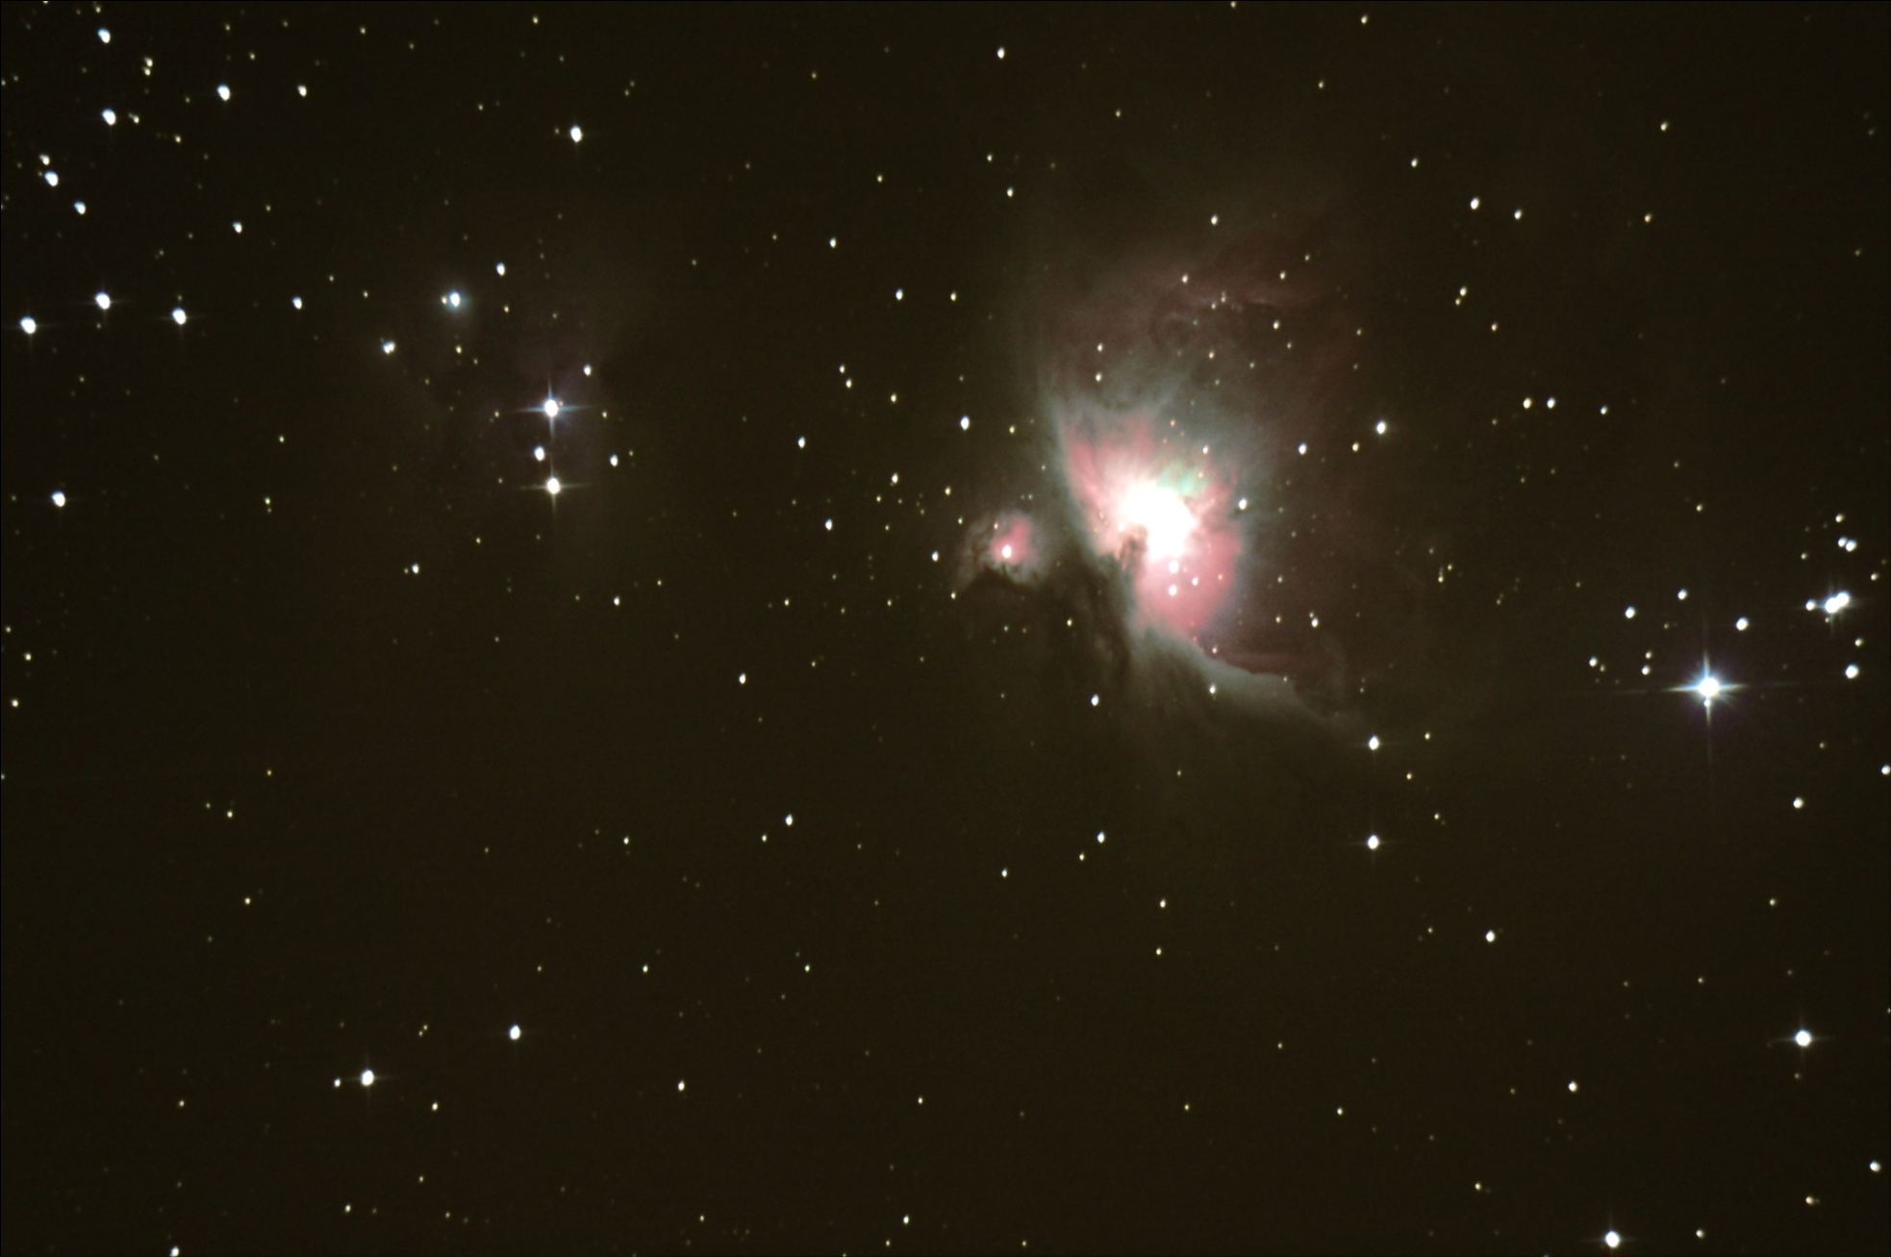
M42 (Wielka Mgławica w Orionie)

Slide 16
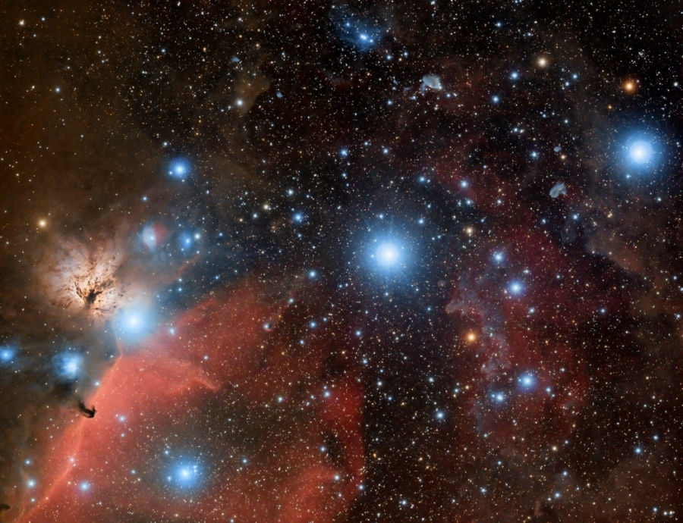
Pas Oriona
Notes:
Alnitak, Alnilam, and Mintaka, are the bright bluish stars from east to west (left to right) along the diagonal in this gorgeous cosmic vista. Otherwise known as the Belt of Orion, these three blue supergiant stars are hotter and much more massive than the Sun. They lie about 1,500 light-years away, born of Orion's well-studied interstellar clouds. In fact, clouds of gas and dust adrift in this region have intriguing and some surprisingly familiar shapes, including the dark Horsehead Nebula and Flame Nebula near Alnitak at the lower left. The famous Orion Nebula itself lies off the bottom of this colorful star field. Recorded last December with a modified digital SLR camera and small telescope, the well-planned, two frame mosaic spans about 4 degrees on the sky. Copyright: Sergi Verdugo Martínez

Slide 17
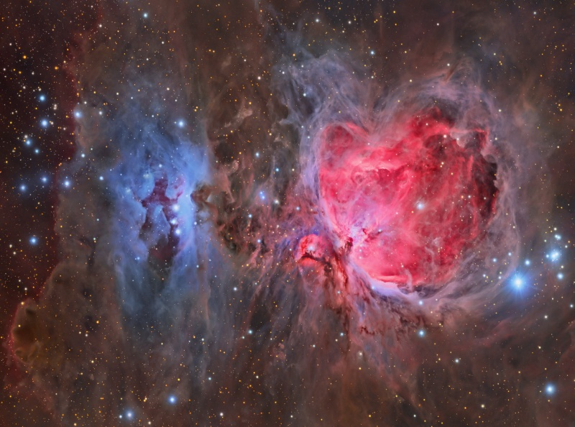
M42 (Wielka Mgławica w Orionie)
Tony Hallas
Notes:
Great Orion Nebulae Credit & Copyright: Tony Hallas Explanation: The Great Nebula in Orion, also known as M42, is one of the most famous nebulae in the sky. The star forming region's glowing gas clouds and hot young stars are on the right in this sharp and colorful two frame mosaic that includes the smaller nebula M43 near center and dusty, bluish reflection nebulae NGC 1977 and friends on the left. Located at the edge of an otherwise invisible giant molecular cloud complex, these eye-catching nebulae represent only a small fraction of this galactic neighborhood's wealth of interstellar material. Within the well-studied stellar nursery, astronomers have also identified what appear to be numerous infant solar systems. The gorgeous skyscape spans nearly two degrees or about 45 light-years at the Orion Nebula's estimated distance of 1,500 light-years.

Slide 18
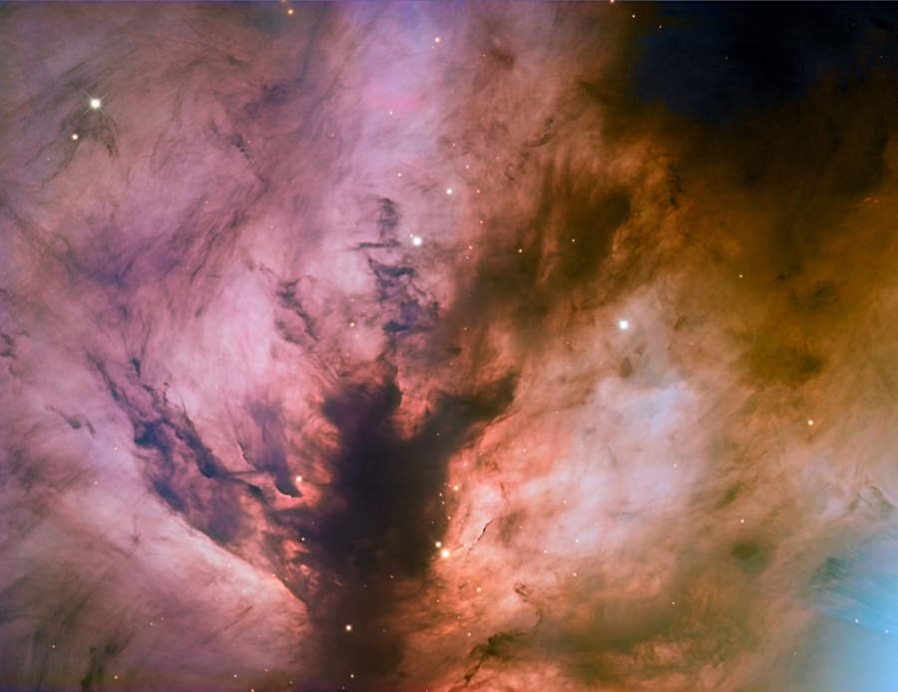
NGC 2024 (Mgławica Płomień)
Adam Block, Mt. Lemmon SkyCenter
Notes:
Flame Nebula Close-Up Image Credit & Copyright: Adam Block, Mt. Lemmon SkyCenter, U. Arizona Explanation: Of course, the Flame Nebula is not on fire. Also known as NGC 2024, the nebula's suggestive reddish color is due to the glow of hydrogen atoms at the edge of the giant Orion molecular cloud complex some 1,500 light-years away. The hydrogen atoms have been ionized, or stripped of their electrons, and glow as the atoms and electrons recombine. But what ionizes the hydrogen atoms? In this close-up view, the central dark lane of absorbing interstellar dust stands out in silhouette against the hydrogen glow and actually hides the true source of the Flame Nebula's energy from optical telescopes. Behind the dark lane lies a cluster of hot, young stars, seen at infrared wavelengths through the obscuring dust. A young, massive star in that cluster is the likely source of energetic ultraviolet radiation that ionizes the hydrogen gas in the Flame Nebula.

Slide 19
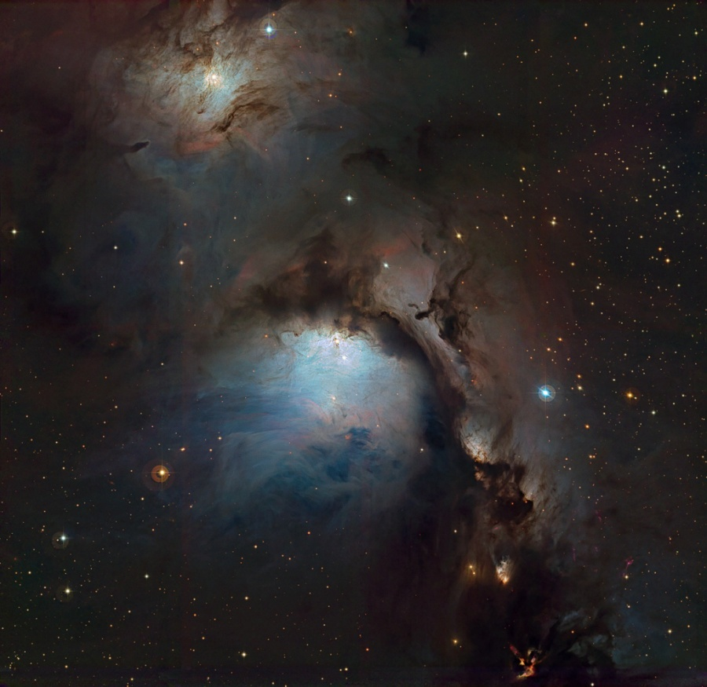
Jak powstają barwne obrazy nieba?
M78
Notes:
M78 isn't really hiding in planet Earth's night sky. About 1,600 light-years away and nestled in the nebula rich constellation Orion, the large, bright, reflection nebula is well-known to telescopic skygazers. But this gorgeous image of M78 was selected as the winner of the Hidden Treasures 2010 astrophotography competition. Held by the European Southern Observatory (ESO), the competition challenged amateur astronomers to process data from ESO's astronomical archive in search of cosmic gems. The winning entry shows off amazing details within bluish M78 (center) embraced in dark, dusty clouds, along with a smaller reflection nebula in the region, NGC 2071 (top). Yellowish and even more compact, the recently discovered, variable McNeil's Nebula is prominent in the scene below and right of center. Based on data from ESO's WFI camera and 2.2 meter telescope at La Silla, Chile, this image spans just over 0.5 degrees on the sky. That corresponds to 15 light-years at the estimated distance of M78. Credit: ESO / Igor Chekalin

Slide 20
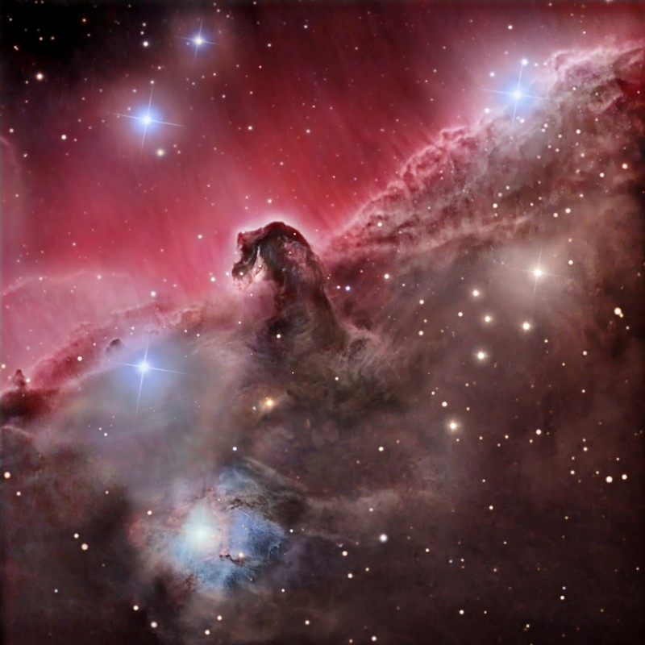
Jak powstają barwne obrazy nieba?
Trzy teleskopy
Filtry wąsko i
szerokopasmowe
Marco Burali, Tiziano Capecchi,
Marco Mancini (Osservatorio MTM)
Notes:
The Magnificent Horsehead Nebula Image Credit & Copyright: Marco Burali, Tiziano Capecchi, Marco Mancini (Osservatorio MTM) Explanation: Sculpted by stellar winds and radiation, a magnificent interstellar dust cloud by chance has assumed this recognizable shape. Fittingly named the Horsehead Nebula, it is some 1,500 light-years distant, embedded in the vast Orion cloud complex. About five light-years "tall", the dark cloud is cataloged as Barnard 33 and is visible only because its obscuring dust is silhouetted against the glowing red emission nebula IC 434. Stars are forming within the dark cloud. Contrasting blue reflection nebula NGC 2023, surrounding a hot, young star, is at the lower left. The gorgeous color image combines both narrowband and broadband images recorded using three different telescopes.

Slide 21
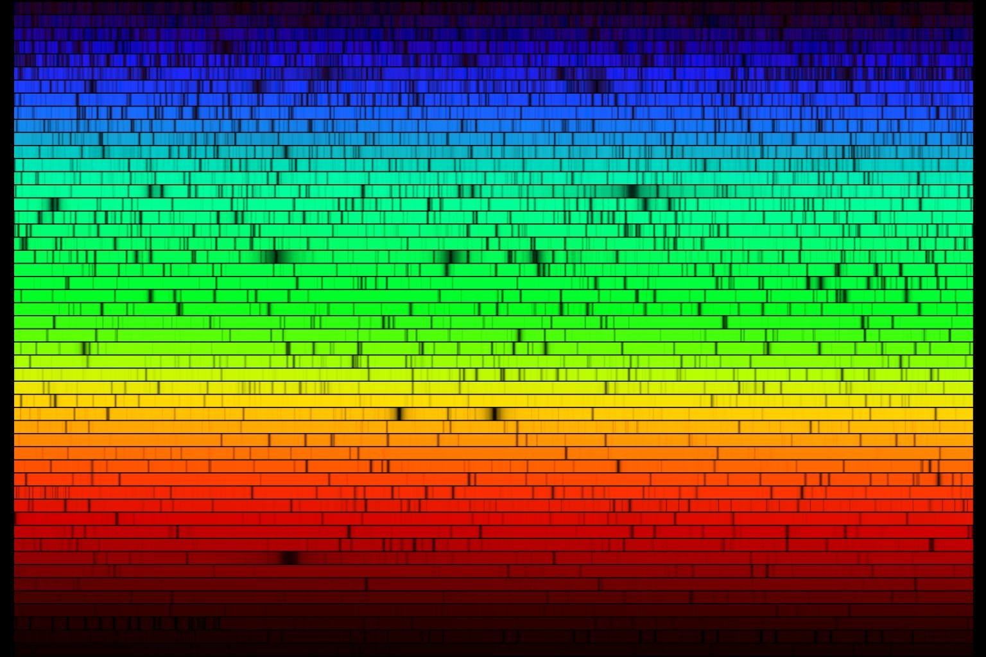
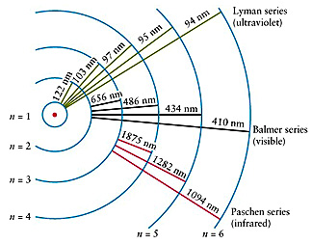
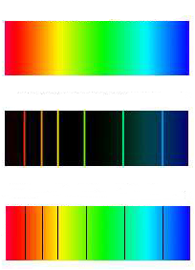
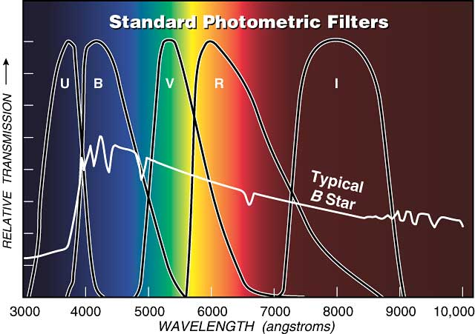
Widmo promieniowania elektromagnetycznego

Slide 22
Powstawanie obserwowanego widma
Obłok materii
Obiekt promieniujący
jak ciało doskonale czarne
Obserwator widzi widmo absorpcyjne
Obserwator widzi widmo ciągłe
Obserwator widzi widmo emisyjne

Slide 23
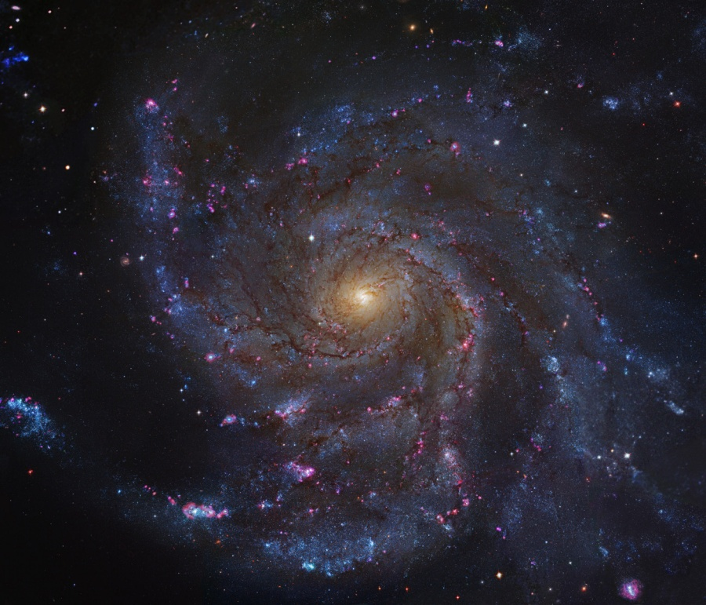
Jak powstają barwne obrazy nieba?
M101
Notes:
Big, beautiful spiral galaxy M101 is one of the last entries in Charles Messier's famous catalog, but definitely not one of the least. About 170,000 light-years across, this galaxy is enormous, almost twice the size of our own Milky Way galaxy. M101 was also one of the original spiral nebulae observed by Lord Rosse's large 19th century telescope, the Leviathan of Parsontown. This mosaic of M101 was assembled from Hubble Legacy Archive data. Additional ground-based data was included to further define the telltale reddish emission from atomic hydrogen gas in this gorgeous galaxy's star forming regions. The sharp image shows stunning features in the galaxy's face-on disk of stars and dust along with background galaxies, some visible right through M101 itself. Also known as the Pinwheel Galaxy, M101 lies within the boundaries of the northern constellation Ursa Major, about 25 million light-years away.

Slide 24
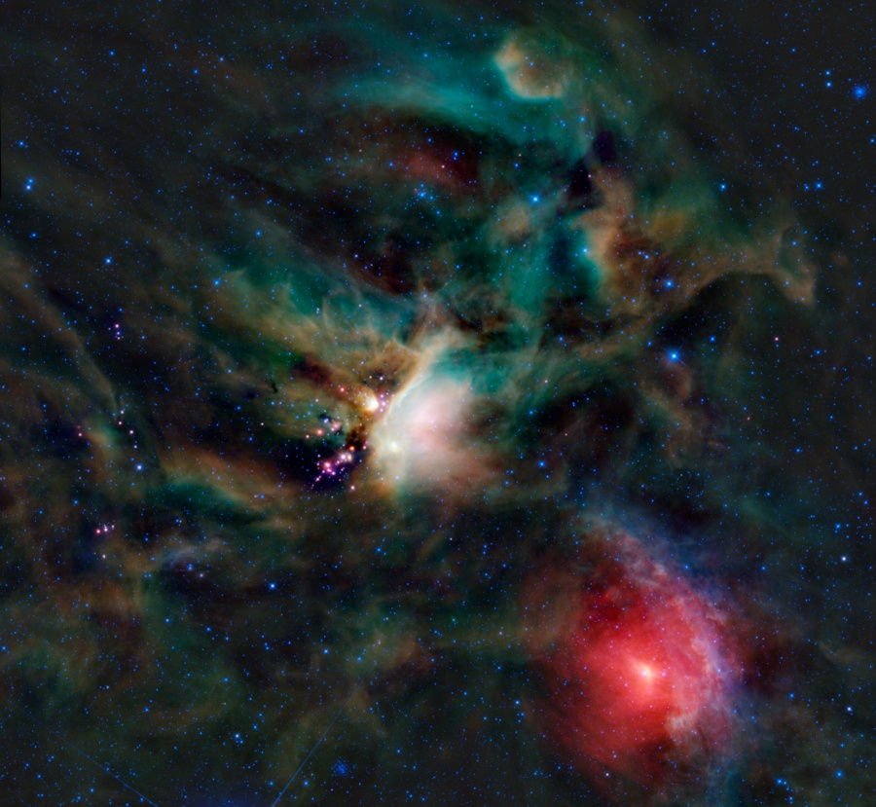
Jak powstają barwne obrazy nieba?
Notes:
Dust clouds and embedded newborn stars glow at infrared wavelengths in this tantalizing false-color composition from WISE, the Wide-field Infrared Survey Explorer. The cosmic canvas features one of the closest star forming regions, part of the Rho Ophiuchi cloud complex some 400 light-years distant near the southern edge of the pronounceable constellation Ophiuchus. After forming along a large cloud of cold molecular hydrogen gas, young stars heat the surrounding dust to produce the infrared glow. Stars in the process of formation, called young stellar objects or YSOs, are embedded in the compact pinkish nebulae seen here, but are otherwise hidden from the prying eyes of optical telescopes. An exploration of the region in penetrating infrared light has detected emerging and newly formed stars whose average age is estimated to be a mere 300,000 years. That's extremely young compared to the Sun's age of 5 billion years. The prominent reddish nebula at the lower right surrounding the star Sigma Scorpii is a reflection nebula produced by dust scattering starlight. This view from WISE spans almost 2 degrees and covers about 14 light-years at the estimated distance of the Rho Ophiuchi cloud.

Slide 25
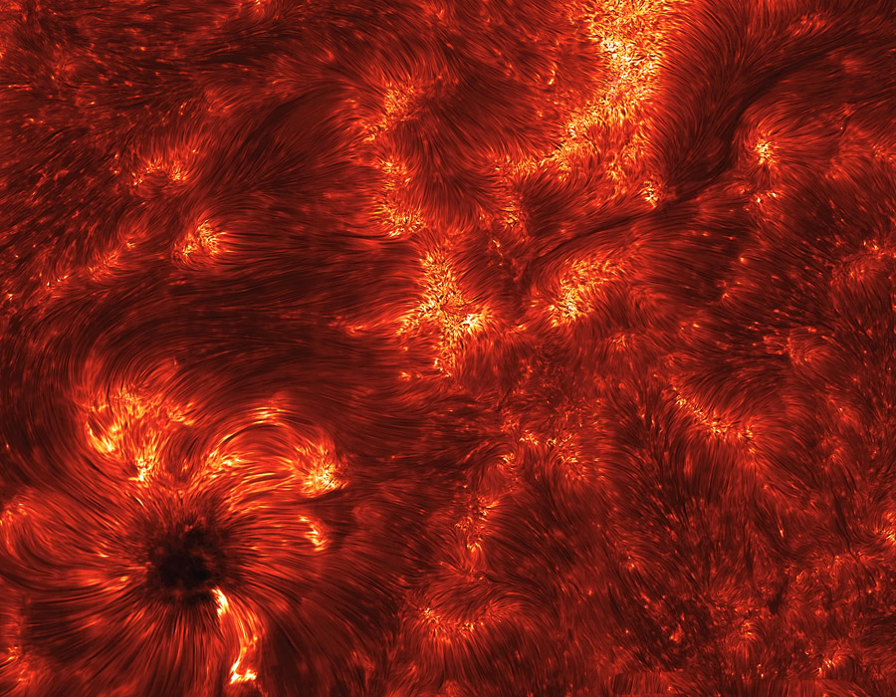
Jak powstają barwne obrazy nieba?
Notes:
Spicules: Jets on the Sun Credit: K. Reardon (Osservatorio Astrofisico di Arcetri, INAF) IBIS, DST, NSO Explanation: Imagine a pipe as wide as a state and as long as the Earth. Now imagine that this pipe is filled with hot gas moving 50,000 kilometers per hour. Further imagine that this pipe is not made of metal but a transparent magnetic field. You are envisioning just one of thousands of young spicules on the active Sun. Pictured above is one of the highest resolution image yet of these enigmatic solar flux tubes. Spicules line the above frame of solar active region 11092 that crossed the Sun last month, but are particularly evident converging on the sunspot on the lower left. Time-sequenced images have recently shown that spicules last about five minutes, starting out as tall tubes of rapidly rising gas but eventually fading as the gas peaks and falls back down to the Sun. What determines the creation and dynamics of spicules remains a topic of active research.

Slide 26
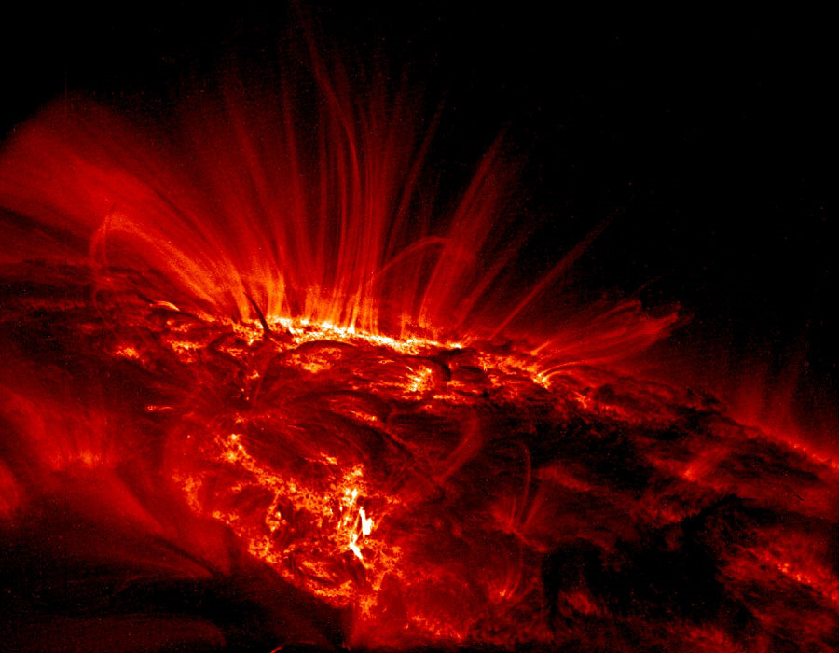
Słońce
Notes:
It was a quiet day on the Sun. The above image shows, however, that even during off days the Sun's surface is a busy place. Shown in ultraviolet light, the relatively cool dark regions have temperatures of thousands of degrees Celsius. Large sunspot group AR 9169 from the last solar cycle is visible as the bright area near the horizon. The bright glowing gas flowing around the sunspots has a temperature of over one million degrees Celsius. The reason for the high temperatures is unknown but thought to be related to the rapidly changing magnetic field loops that channel solar plasma. Large sunspot group AR 9169 moved across the Sun during 2000 September and decayed in a few weeks.

Slide 27
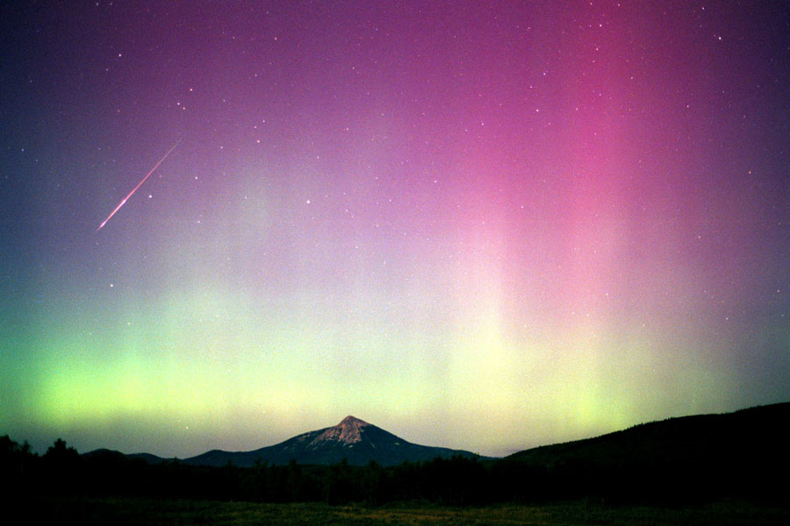
Jak powstają barwne obrazy nieba?
Notes:
Aurora Persei Credit & Copyright: Jimmy Westlake (Colorado Mountain College) Explanation: Dark skies are favored for viewing meteor showers -- so the best viewing of this year's Perseids will occur in the early morning. While the Perseid meteor shower is scheduled to peak over the next few days, bright light from a gibbous Moon will also flood the early evening and mask the majority of relatively faint meteors. Still, skygazing in the early morning after the Moon sets (after about 2 AM local time) could reveal many faint meteors. Persistant observing at any time after sunset can reward northern hemisphere watchers looking for occasional Perseid fireballs. Astronomer Jimmy Westlake imaged this bright Perseid meteor despite the combination of moonlight and auroral glow over Colorado skies in August of 2000.

Slide 28
Jak powstają barwne obrazy nieba?
Notes:
Intense auroral activity flooded the night with shimmering colors on February 24, captured here from a lodge near the city of Yellowknife in northern Canada. The stunning sequence (left to right) of three all-sky exposures, taken at 30 second intervals, shows rapid changes in dancing curtains of northern lights against a starry background. What makes the northern lights dance? Measurements by NASA's fleet of THEMIS spacecraft indicate that these explosions of auroral activity are driven by sudden releases of energy in the Earth's magnetosphere called magnetic reconnection events. The reconnection events release energy when magnetic field lines snap like rubber bands, driving charged particles into the upper atmosphere. Stretching into space, these reconnection events occur in the magnetosphere on the Earth's night side at a distance about 1/3 of the way to the Moon.

Slide 29
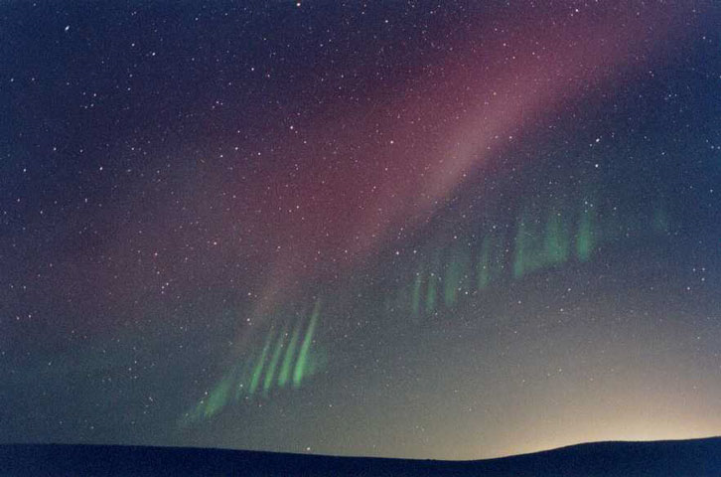
Jak powstają barwne obrazy nieba?
Notes:
Rays from an Unexpected Aurora Credit & Copyright: Lyndon Anderson (Prairie Journal) Explanation: This aurora was a bit of a surprise. For starters, on this Friday morning in August 2002, no intense auroral activity was expected at all. Possibly more surprising, however, the aurora appeared to show an usual structure of green rays from some locations. In the above image, captured from North Dakota, USA, a picket fence of green rays stretches toward the horizon. Mirroring the green rays is a red band, somewhat rare in its own right. Lights from the cities of Bismarck and Mandan are visible near the horizon. Large sunspot groups indicate that activity from an active Sun is relatively likely, possibly causing other streams of energetic particles to cascade onto the Earth and so causing more auroras.

Slide 30
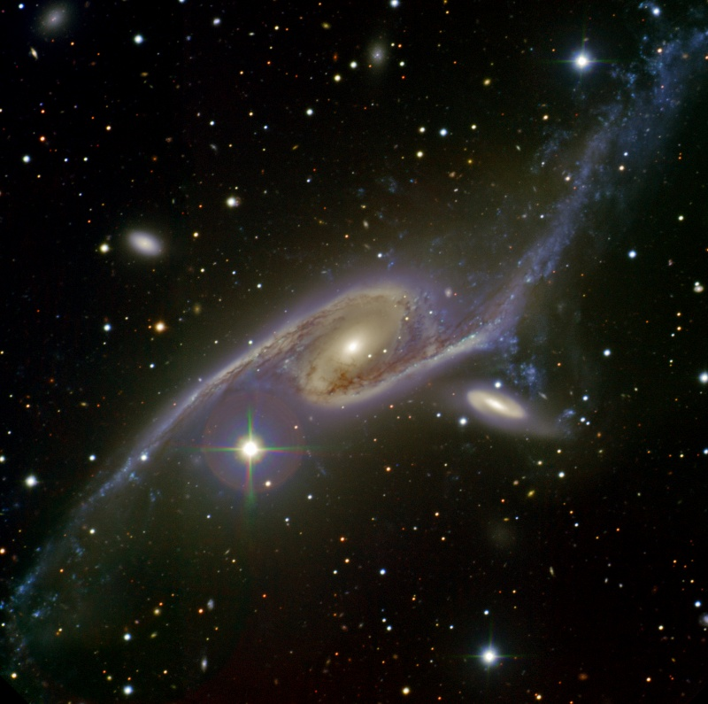
Galaktyki
Notes:
Over 400,000 light years across NGC 6872 is an enormous spiral galaxy, at least 4 times the size of our own very large Milky Way. About 200 million light-years distant, toward the southern constellation Pavo, the Peacock, the remarkable galaxy's stretched out shape is due to its ongoing gravitational interaction, likely leading to an eventual merger, with the nearby smaller galaxy IC 4970. IC 4970 is seen just below and right of the giant galaxy's core in this cosmic color portrait from the 8 meter Gemini South telescope in Chile. The idea to image this titanic galaxy collision comes from a winning contest essay submitted last year to the Gemini Observatory by the Sydney Girls High School Astronomy Club. In addition to inspirational aspects and aesthetics, club members argued that a color image would be more than just a pretty picture. In their winning essay they noted that "If enough colour data is obtained in the image it may reveal easily accessible information about the different populations of stars, star formation, relative rate of star formation due to the interaction, and the extent of dust and gas present in these galaxies". (Editor's note: For Australian schools, 2011 contest information is here.)

Slide 31
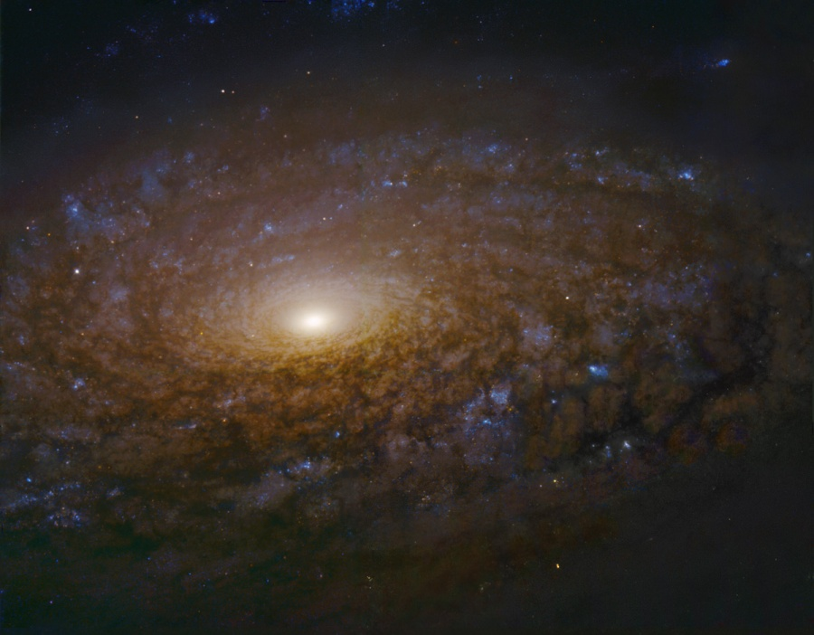
Galaktyki
Notes:
: Gorgeous spiral galaxy NGC 3521 is a mere 35 million light-years distant, toward the constellation Leo. Spanning some 50,000 light-years, its central region is shown in this dramatic image, constructed from data drawn from the Hubble Legacy Archive. The close-up view highlights this galaxy's characteristic multiple, patchy, irregular spiral arms laced with dust and clusters of young, blue stars. In contrast, many other spirals exhibit grand, sweeping arms. A relatively bright galaxy in planet Earth's sky, NGC 3521 is easily visible in small telescopes, but often overlooked by amateur imagers in favor of other Leo spiral galaxies, like M66 and M65. Hubble Legacy Archive, ESA, NASA Processing - Robert Gendler

Slide 32
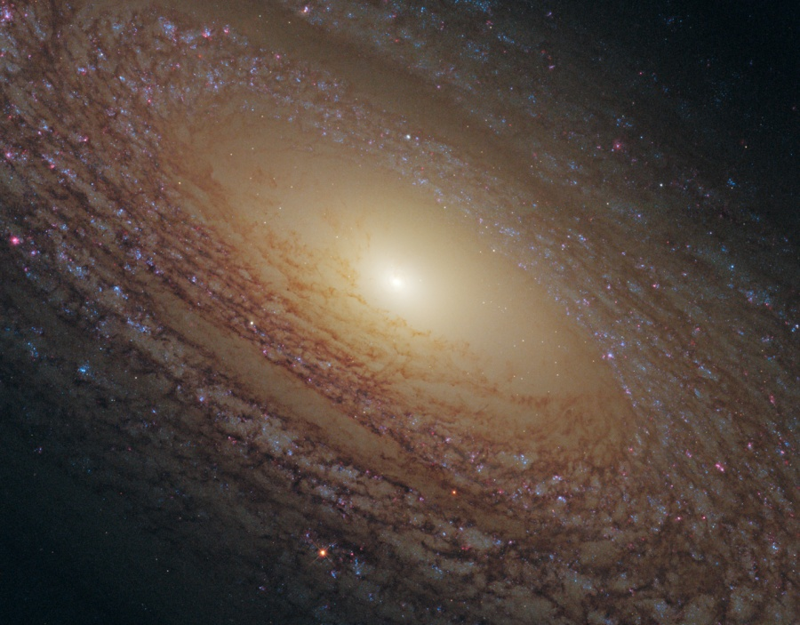
Galaktyki
Notes:
A mere 46 million light-years distant, spiral galaxy NGC 2841 can be found in the northern constellation of Ursa Major. This sharp view of the gorgeous island universe shows off a striking yellow nucleus and galactic disk. Dust lanes, small, pink star-forming regions, and young blue star clusters are embedded in the patchy, tightly wound spiral arms. In contrast, many other spirals exhibit grand, sweeping arms with large star-forming regions. NGC 2841 has a diameter of over 150,000 light-years, even larger than our own Milky Way, but this close-up Hubble image spans about 34,000 light-years along the galaxy's inner region. X-ray images suggest that resulting winds and stellar explosions create plumes of hot gas extending into a halo around NGC 2841. Credit: NASA, ESA, and the Hubble Heritage (STScI / AURA) - ESA / Hubble Collaboration

Slide 33
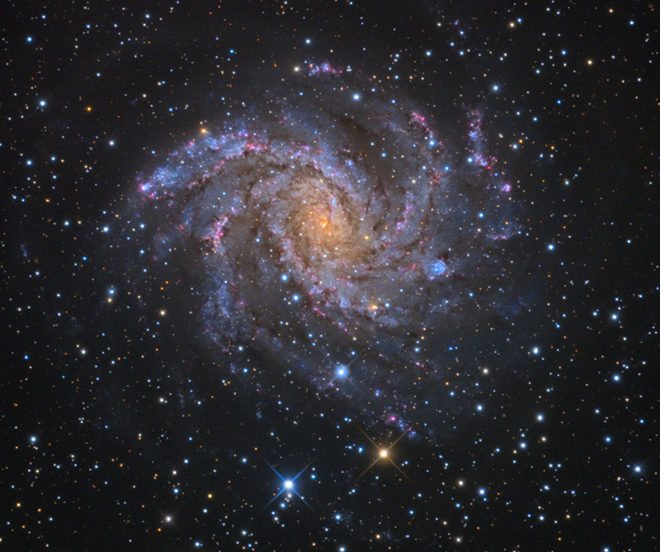
Galaktyki
Notes:
Celebrate the New Year with the Fireworks Galaxy! Also known as NGC 6946, the big, beautiful spiral galaxy is located just 10 million light-years away, behind a veil of foreground dust and stars in the high and far-off constellation of Cepheus. From our vantage point in the Milky Way Galaxy, we see NGC 6946 face-on. In this colorful cosmic portrait, the galaxy's colors change from the yellowish light of old stars in the core to young blue star clusters and reddish star forming regions along the loose, fragmented spiral arms. NGC 6946 is bright in infrared light and rich in gas and dust, exhibiting a furious rate of star formation. Nearly 40,000 light-years across, the nearby spiral is fittingly referred to as the Fireworks Galaxy. Over the last 100 years, at least nine supernovae, the death explosions of massive stars, were discovered in NGC 6946. By comparison, the average rate for supernovae in the Milky Way is about 1 per century. Copyright: Adam Block, Mt. Lemmon SkyCenter, U. Arizona

Slide 34
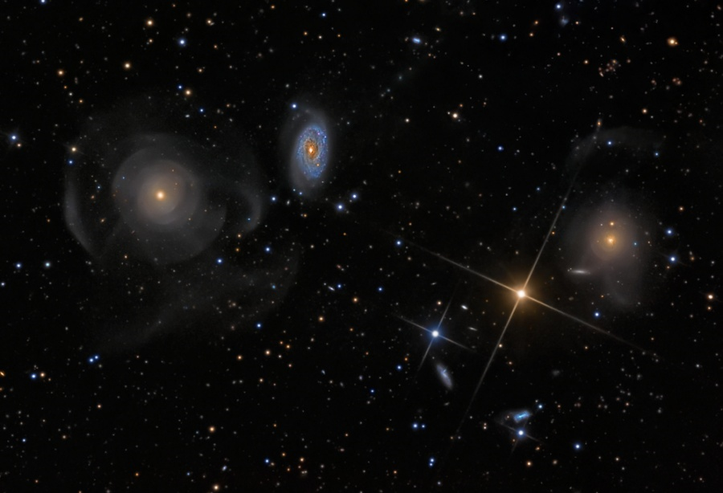
Galaktyki
Notes:
This colorful cosmic skyscape features a peculiar system of galaxies cataloged as Arp 227 some 100 million light-years distant. Swimming within the boundaries of the constellation Pisces, Arp 227 consists of the two galaxies prominent on the left; the curious shell galaxy NGC 474 and its blue, spiral-armed neighbor NGC 470. The faint, wide arcs or shells of NGC 474 could have been formed by a gravitational encounter with neighbor NGC 470. Alternately the shells could be caused by a merger with a smaller galaxy producing an effect analogous to ripples across the surface of a pond. Remarkably, the large galaxy on the right hand side of the deep image, NGC 467, appears to be surrounded by faint shells too, evidence of another interacting galaxy system. Intriguing background galaxies are scattered around the field that also includes spiky foreground stars. Of course, those stars lie well within our own Milky Way Galaxy. The field of view spans 25 arc minutes or about 1/2 degree on the sky. Copyright: Stephen Leshin

Slide 35
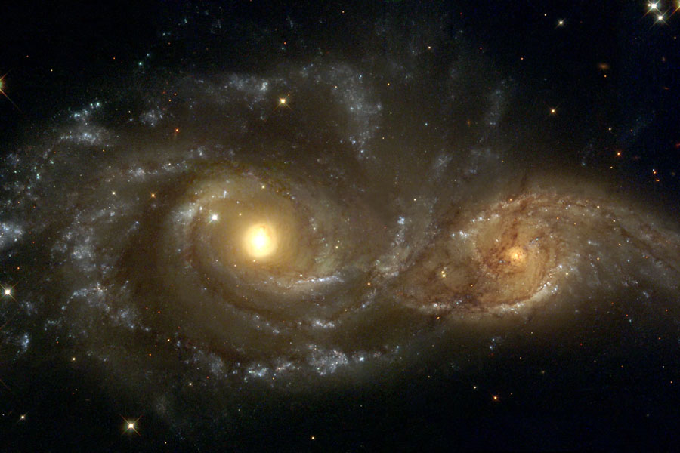
Galaktyki
Notes:
Spiral Galaxies in Collision Credit: Debra Meloy Elmegreen (Vassar College) et al., & the Hubble Heritage Team (AURA/STScI/NASA) Explanation: Billions of years from now, only one of these two galaxies will remain. Until then, spiral galaxies NGC 2207 and IC 2163 will slowly pull each other apart, creating tides of matter, sheets of shocked gas, lanes of dark dust, bursts of star formation, and streams of cast-away stars. Astronomers predict that NGC 2207, the larger galaxy on the left, will eventually incorporate IC 2163, the smaller galaxy on the right. In the most recent encounter that peaked 40 million years ago, the smaller galaxy is swinging around counter-clockwise, and is now slightly behind the larger galaxy. The space between stars is so vast that when galaxies collide, the stars in them usually do not collide.

Slide 36
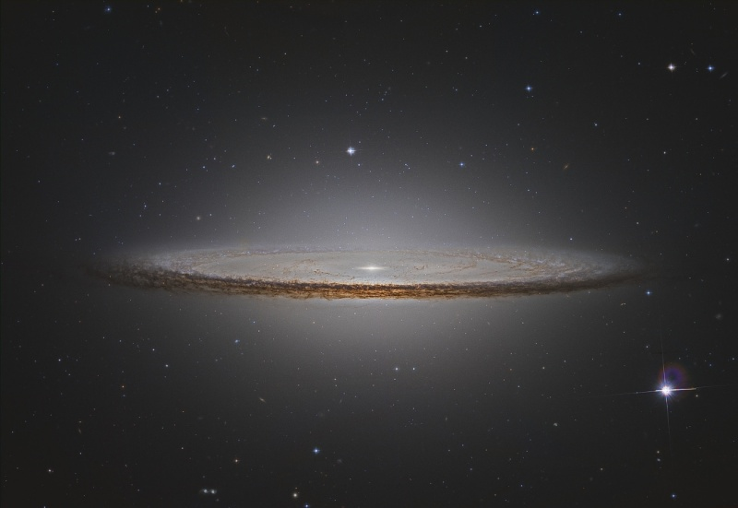
Galaktyki
Notes:
M104 Hubble Remix Credit & Copyright: Vicent Peris (OAUV / PTeam), MAST, STScI, AURA, NASA Explanation: The striking spiral galaxy M104 is famous for its nearly edge-on profile featuring a broad ring of obscuring dust. Seen in silhouette against a bright bulge of stars, the swath of cosmic dust lanes lends a hat-like appearance to the galaxy in optical images suggesting the more popular moniker, The Sombrero Galaxy. Here, Hubble Space Telescope archival image data has been reprocessed to create this alternative look at the well-known galaxy. The newly developed processing improves the visibility of details otherwise lost in overwhelming glare, in this case allowing features of the galaxy's dust lanes to be followed well into the bright central region. About 50,000 light-years across and 28 million light-years away, M104 is one of the largest galaxies at the southern edge of the Virgo Galaxy Cluster.

Slide 37
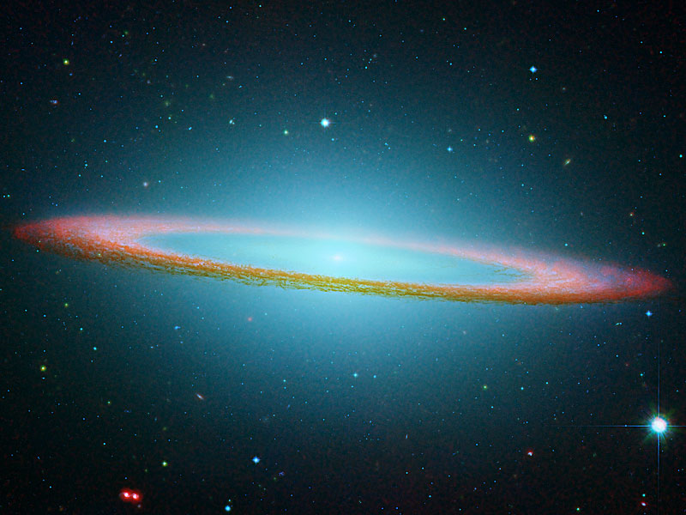
Galaktyki
Notes:
The Sombrero Galaxy in Infrared Credit: R. Kennicutt (Steward Obs.) et al., SSC, JPL, Caltech, NASA Explanation: This floating ring is the size of a galaxy. In fact, it is part of the photogenic Sombrero Galaxy, one of the largest galaxies in the nearby Virgo Cluster of Galaxies. The dark band of dust that obscures the mid-section of the Sombrero Galaxy in optical light actually glows brightly in infrared light. The above image shows the infrared glow, recently recorded by the orbiting Spitzer Space Telescope, superposed in false-color on an existing image taken by NASA's Hubble Space Telescope in optical light. The Sombrero Galaxy, also known as M104, spans about 50,000 light years across and lies 28 million light years away. M104 can be seen with a small telescope in the direction of the constellation Virgo.

Slide 38
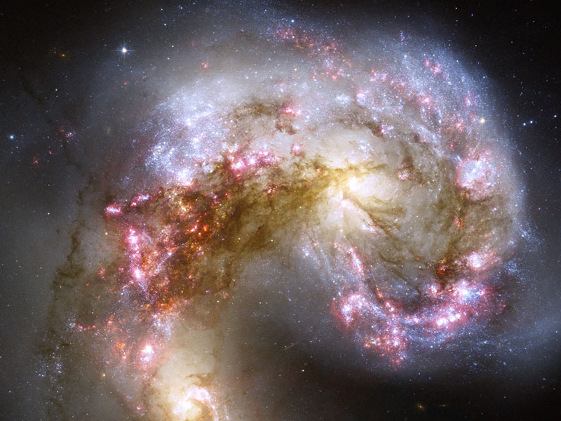
Galaktyki
Notes:
The Antennae Galaxies in Collision Credit: NASA, ESA, and the Hubble Heritage Team (STScI/AURA)-ESA/Hubble Collaboration Acknowledgment: B. Whitmore (Space Telescope Science Institute) et al. Explanation: Two galaxies are squaring off in Corvus and here are the latest pictures. When two galaxies collide, however, the stars that compose them usually do not. This is because galaxies are mostly empty space and, however bright, stars only take up only a small amount of that space. During the slow, hundred million year collision, however, one galaxy can rip the other apart gravitationally, and dust and gas common to both galaxies does collide. In the above clash of the titans, dark dust pillars mark massive molecular clouds are being compressed during the galactic encounter, causing the rapid birth of millions of stars, some of which are gravitationally bound together in massive star clusters.

Slide 39
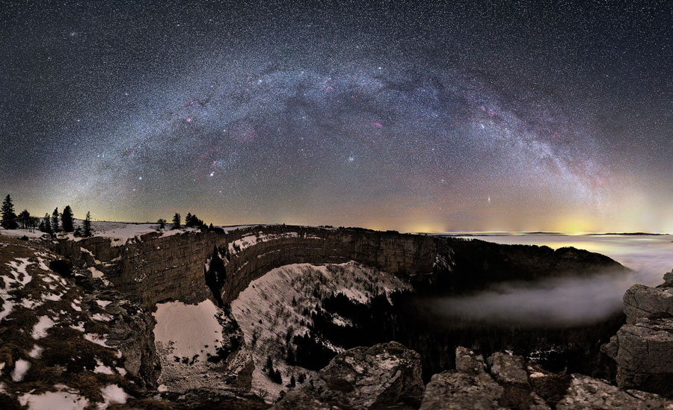
Droga Mleczna
Notes:
What's visible in the night sky during this time of year? To help illustrate the answer, a beautiful land, cloud, and skyscape was captured earlier this month over Neuchâtel, Switzerland. Visible in the foreground were the snow covered cliffs of the amphitheater shaped Creux du Van, as well as distant trees, and town-lit clouds. Visible in the night sky (at midnight) were galaxies including the long arch of the central band of our Milky Way Galaxy, the Andromeda galaxy (M31), and the Triangulum galaxy (M33). Star clusters visible included NGC 752, M34, M35, M41, the double cluster, and the Beehive (M44). Nebulas visible included the Orion Nebula (M42), NGC 7822, IC 1396, the Rosette Nebula, the Flaming Star Nebula, the California Nebula, the Heart and Soul Nebulas, and the Pacman Nebula. Rolling your cursor over the above image will bring up labels for all of these. But the above wide angle sky image captured even more sky wonders. What other nebulas can you find in the above image? Credit: Stephane Vetter (Nuits sacrees)

Slide 40
Droga Mleczna
Notes:
A Graceful Arc Credit & Copyright: Tony Hallas Explanation: The graceful arc of the Milky Way begins and ends at two mountain peaks in this solemn night sky panorama. The view was created from a 24 frame mosaic, with exposures tracking Earth and sky separately. In the final composition, northern California's Mount Lassen was positioned at the left and Mount Shasta at the far right, just below the star and dust clouds of the galactic center. Lassen and Shasta are volcanoes in the Cascade Mountain Range of North America, an arc of the volcanic Pacific Ring of Fire. In the dim, snow-capped peaks, planet Earth seems to echo the subtle glow of the Milky Way's own faint, unresolved starlight.

Slide 41
Droga Mleczna
Notes:
Carina Nebula Panorama from Hubble Credit: NASA, ESA, N. Smith (U. California, Berkeley) et al., and The Hubble Heritage Team (STScI/AURA) Explanation: In one of the brightest parts of Milky Way lies a nebula where some of the oddest things occur. NGC 3372, known as the Great Nebula in Carina, is home to massive stars and changing nebulas. Eta Carinae, the most energetic star in the nebula, was one of the brightest stars in the sky in the 1830s, but then faded dramatically. The Keyhole Nebula, visible left of center, houses several of the most massive stars known and has also changed its appearance. The entire Carina Nebula spans over 300 light years and lies about 7,500 light-years away in the constellation of Carina. Pictured above is the most detailed image of the Carina Nebula ever taken. The controlled color image is a composite of 48 high-resolution frames taken by the Hubble Space Telescope two years ago. Wide-field annotated and zoomable image versions are also available.
466diggsdigg

Slide 42
Droga Mleczna
Notes:
IC 5067 in the Pelican Nebula Credit & Copyright: Antonio Fernandez Explanation: The prominent ridge of emission featured in this dramatic skyscape is cataloged as IC 5067. Part of a larger emission nebula with a distinctive shape, popularly called The Pelican Nebula, the ridge spans about 10 light-years following the curve of the cosmic pelican's head and neck. This false color view also translates the pervasive glow of narrow emission lines from atoms in the nebula to a color palette made popular in Hubble Space Telescope images of star forming regions. Fantastic, dark shapes inhabiting the 1/2 degree wide field are clouds of cool gas and dust sculpted by the winds and radiation from hot, massive stars. Close-ups of some of the sculpted clouds show clear signs of newly forming stars. The Pelican Nebula, itself cataloged as IC 5070, is about 2,000 light-years away. To find it, look northeast of bright star Deneb in the high flying constellation Cygnus.

Slide 43
Droga Mleczna
Notes:
Sagittarius and the Central Milky Way Credit & Copyright: Robert Gendler (robgendlerastropics.com) Explanation: What does the center of our Milky Way Galaxy look like? In visible light, no one knows! It is not possible to see the Galactic center in light our eyes are sensitive to because the thick dust in the plane of our Galaxy obscures it. If one looks in the direction of our Galaxy's center - which is toward the constellation of Sagittarius - many beautiful wonders become apparent, though. Large dust lanes and star clouds dominate the picture. As many as 30 Messier Objects are visible in the above spectacular image mosaic, including all types of nebulas and star clusters. Two notable nebula include the Lagoon Nebula (M8), a red patch just above and to the right of center, and slightly to its right is the red and blue Trifid Nebula (M20).

Slide 44
Droga Mleczna
Notes:
Star Cluster R136 Bursts Out Credit: NASA, ESA, & F. Paresce (INAF-IASF), R. O'Connell (U. Virginia), & the HST WFC3 Science Oversight Committee Explanation: In the center of star-forming region 30 Doradus lies a huge cluster of the largest, hottest, most massive stars known. These stars, known collectively as star cluster R136, were captured above in visible light by the newly installed Wide Field Camera peering though the recently refurbished Hubble Space Telescope. Gas and dust clouds in 30 Doradus, also known as the Tarantula Nebula, have been sculpted into elongated shapes by powerful winds and ultraviolet radiation from these hot cluster stars. The 30 Doradus Nebula lies within a neighboring galaxy known as the Large Magellanic Cloud and is located a mere 170,000 light-years away.

Slide 45
Droga Mleczna
Notes:
The Colors of IC 1795 Credit & Copyright: Don Goldman Explanation: This colorful cosmic portrait features glowing gas and obscuring dust clouds in IC 1795, a star forming region in the northern constellation Cassiopeia. The nebula's colors were created by adopting the Hubble false-color palette for mapping narrow emission from oxygen, hydrogen, and sulfur atoms to blue, green and red colors, and further blending the data with images of the region recorded through broadband filters. Not far on the sky from the famous Double Star Cluster in Perseus, IC 1795 is itself located next to IC 1805, the Heart Nebula, as part of a complex of star forming regions that lie at the edge of a large molecular cloud. Located just over 6,000 light-years away, the larger star forming complex sprawls along the Perseus spiral arm of our Milky Way Galaxy. At that distance, this picture would span about 70 light-years across IC 1795.

Slide 46
Droga Mleczna
Notes:
Dust Pillar of the Carina Nebula Credit: NASA, ESA, and M. Livio and the Hubble 20th Anniversary Team (STScI) Explanation: Inside the head of this interstellar monster is a star that is slowly destroying it. The monster, on the right, is actually an inanimate pillar of gas and dust that measures over a light year in length. The star, not itself visible through the opaque dust, is bursting out partly by ejecting energetic beams of particles. Similar epic battles are being waged all over the star-forming Carina Nebula. The stars will win in the end, destroying their pillars of creation over the next 100,000 years, and resulting in a new open cluster of stars. The pink dots around the image are newly formed stars that have already been freed from their birth monster. The above image was released last week in commemoration of the Hubble Space Telescopes 20th year of operation. The technical name for the stellar jets are Herbig-Haro objects. How a star creates Herbig-Haro jets is an ongoing topic of research, but it likely involves an accretion disk swirling around a central star. A second impressive Herbig-Haro jet occurs diagonally near the image center.

Slide 47
Droga Mleczna
Notes:
The Elusive Jellyfish Nebula Image Credit & Copyright: Bob Franke Explanation: Normally faint and elusive, the Jellyfish Nebula is caught in this alluring, false-color, telescopic view. Flanked by two bright stars, Mu and Eta Geminorum, at the foot of a celestial twin, the Jellyfish Nebula is the brighter arcing ridge of emission with dangling tentacles below and right of center. In fact, the cosmic jellyfish is seen to be part of bubble-shaped supernova remnant IC 443, the expanding debris cloud from a massive star that exploded. Light from the explosion first reached planet Earth over 30,000 years ago. Like its cousin in astrophysical waters the Crab Nebula supernova remnant, IC 443 is known to harbor a neutron star, the remnant of the collapsed stellar core. Emission nebula Sharpless 249 fills the field at the upper left. The Jellyfish Nebula is about 5,000 light-years away. At that distance, this image would be about 300 light-years across. The color scheme used in the narrowband composite was made popular in Hubble Space Telescope images, mapping emission from oxygen, hydrogen, and sulfur atoms to blue, green and red colors.

Slide 48
Droga Mleczna
Notes:
AE Aurigae is the bright star below and left of center in this evocative portrait of IC 405, also known as the Flaming Star Nebula. Embedded in the cosmic cloud, the hot, variable O-type star energizes the glow of hydrogen along convoluted filaments of atomic gas, its blue starlight scattered by interstellar dust. But AE Aurigae wasn't formed in the nebula it illuminates. Retracing the star's motion through space, astronomers conclude that AE Aurigae was probably born in the Orion Nebula. Close gravitational encounters with other stars ejected it from the region, along with another O star, Mu Columbae, over two million years ago. The runaway stars have drifted in opposite directions ever since, separating at about 200 kilometers per second. This sharp, detailed image of IC 405 spans over 5 light-years at the nebula's estimated distance of 1,500 light-years in the northern constellation Auriga, the Charioteer. Copyright: Rolf Geissinger

Slide 49
Droga Mleczna
Notes:
What's California doing in space? Drifting through the Orion Arm of the spiral Milky Way Galaxy, this cosmic cloud by chance echoes the outline of California on the west coast of the United States. Our own Sun also lies within the Milky Way's Orion Arm, only about 1,500 light-years from the California Nebula. Also known as NGC 1499, the classic emission nebula is around 100 light-years long. On many images, the most prominent glow of the California Nebula is the red light characteristic of hydrogen atoms recombining with long lost electrons, stripped away (ionized) by energetic starlight. In the above image, however, hydrogen is colored green, while sulfur is mapped to red and oxygen mapped to blue. The star most likely providing the energetic starlight that ionizes much of the nebular gas is the bright, hot, bluish Xi Persei, just outside the right image edge. A regular target for astrophotographers, the California Nebula can be spotted with a wide-field telescope under a dark sky toward the constellation of Perseus, not far from the Pleiades. Markus Noller (Deep Sky Images)

Slide 50
Droga Mleczna
Notes:
Long Stem Rosette Credit & Copyright: Adam Block (Caelum Observatory) and Tim Puckett Explanation: The Rosette Nebula (aka NGC 2237) is not the only cosmic cloud of gas and dust to evoke the imagery of flowers. But it is the one most often suggested as a suitable astronomy image for Valentine's Day. Of the many excellent Rosette Nebula pictures submitted to APOD editors, this view seemed most appropriate, with a long stem of glowing hydrogen gas in the region included in the composition. At the edge of a large molecular cloud in Monoceros, some 5,000 light years away, the petals of this rose are actually a stellar nursery whose lovely, symmetric shape is sculpted by the winds and radiation from its central cluster of hot young stars. The stars in the energetic cluster, cataloged as NGC 2244, are only a few million years old, while the central cavity in the Rosette Nebula is about 50 light-years in diameter. Happy Valentine's Day!

Slide 51
Droga Mleczna
Notes:
Would the Rosette Nebula by any other name look as sweet? The bland New General Catalog designation of NGC 2237 doesn't appear to diminish the appearance of this flowery emission nebula. Inside the nebula lies an open cluster of bright young stars designated NGC 2244. These stars formed about four million years ago from the nebular material and their stellar winds are clearing a hole in the nebula's center, insulated by a layer of dust and hot gas. Ultraviolet light from the hot cluster stars causes the surrounding nebula to glow. The Rosette Nebula spans about 100 light-years across, lies about 5000 light-years away, and can be seen with a small telescope towards the constellation of the Unicorn (Monoceros). Copyright: Brian Lula

Slide 52
Droga Mleczna
Notes:
Hubble's Lagoon Credit: NASA, ESA, Hubble Space Telescope Explanation: Like brush strokes on a canvas, ridges of color seem to flow across this scene. But here, the canvas is nearly 3 light-years wide and the colors map emission from ionized gas in the Lagoon Nebula, recorded by the Hubble Space Telescope's Advanced Camera for Surveys. Also known as M8, the nebula is a star forming region about 5,000 light-years distant in the constellation Sagittarius. Hubble's remarkably sharp, close-up view reveals undulating shapes sculpted by the energetic light and winds from the region's new born stars. Of course, the Lagoon nebula is a popular target for earthbound skygazers, too. It features a prominent dust lane and bright hourglass shape in small telescopes with wider fields of view.

Slide 53
Droga Mleczna
Notes:
M8: The Lagoon Nebula Credit & Copyright: Steve Mazlin, Jack Harvey, Rick Gilbert, and Daniel Verschatse (Star Shadows Remote Observatory, PROMPT, CTIO) Explanation: This beautiful cosmic cloud is a popular stop on telescopic tours of the constellation Sagittarius. Eighteenth century cosmic tourist Charles Messier cataloged the bright nebula as M8. Modern day astronomers recognize the Lagoon Nebula as an active stellar nursery about 5,000 light-years distant, in the direction of the center of our Milky Way Galaxy. Remarkable features can be traced through this sharp picture, showing off the Lagoon's filaments of glowing gas and dark dust clouds. Twisting near the center of the Lagoon, the bright hourglass shape is the turbulent result of extreme stellar winds and intense starlight. The alluring view is a color composite of both broad and narrow band images captured while M8 was high in dark, Chilean skies. It records the Lagoon with a bluer hue than typically represented in images dominated by the red light of the region's hydrogen emission. At the nebula's estimated distance, the picture spans about 30 light-years.

Slide 54
Jak powstają barwne obrazy nieba?
Notes:
The Trifid Nebula is Stars and Dust Credit & Copyright: Robert Gendler; Data Acquisition: Ryan Hannahoe Explanation: Unspeakable beauty and unimaginable bedlam can be found together in the Trifid Nebula. Also known as M20, this photogenic nebula is visible with good binoculars towards the constellation of Sagittarius. The energetic processes of star formation create not only the colors but the chaos. The red-glowing gas results from high-energy starlight striking interstellar hydrogen gas. The dark dust filaments that lace M20 were created in the atmospheres of cool giant stars and in the debris from supernovae explosions. Which bright young stars light up the blue reflection nebula is still being investigated. The light from M20 we see today left perhaps 3,000 years ago, although the exact distance remains unknown. Light takes about 50 years to cross M20.

Slide 55
Gwiazdy
Notes:
The Bubble Nebula Credit & Copyright: Dave Jurasevich (Mount Wilson Observatory) Explanation: Blown by the wind from a massive star, this interstellar apparition has a surprisingly familiar shape. Cataloged as NGC 7635, it is also known simply as The Bubble Nebula. Although it looks delicate, the 10 light-year diameter bubble offers evidence of violent processes at work. Above and right of the Bubble's center is a hot, O-type star, several hundred thousand times more luminous and approximately 45 times more massive than the Sun. A fierce stellar wind and intense radiation from that star has blasted out the structure of glowing gas against denser material in a surrounding molecular cloud. The intriguing Bubble Nebula lies a mere 11,000 light-years away toward the boastful constellation Cassiopeia. A false-color Hubble palette was used to create this sharp image and shows emission from sulfur, hydrogen, and oxygen atoms in red, green, and blue hues. The image data was recorded using a small telescope under clear, steady skies, from Mount Wilson Observatory.

Slide 56
Gwiazdy
Notes:
Like a ship plowing through cosmic seas, runaway star Zeta Ophiuchi produces the arcing interstellar bow wave or bow shock seen in this stunning infrared portrait from the WISE spacecraft. In the false-color view, bluish Zeta Oph, a star about 20 times more massive than the Sun, lies near the center of the frame, moving toward the top at 24 kilometers per second. Its strong stellar wind precedes it, compressing and heating the dusty interstellar material and shaping the curved shock front. Around it are clouds of relatively undisturbed material. What set this star in motion? Zeta Oph was likely once a member of a binary star system, its companion star was more massive and hence shorter lived. When the companion exploded as a supernova catastrophically losing mass, Zeta Oph was flung out of the system. About 460 light-years away, Zeta Oph is 65,000 times more luminous than the Sun and would be one of the brighter stars in the sky if it weren't surrounded by obscuring dust. The WISE image spans about 1.5 degrees or 12 light-years at the estimated distance of Zeta Ophiuchi. Credit: NASA, JPL-Caltech, WISE Team

Slide 57
Gwiazdy
Notes:
Light Echoes from V838 Mon Credit: NASA and the Hubble Heritage Team (AURA/STScI) Explanation: What caused this outburst of V838 Mon? For reasons unknown, star V838 Mon's outer surface suddenly greatly expanded with the result that it became the brightest star in the entire Milky Way Galaxy in January 2002. Then, just as suddenly, it faded. A stellar flash like this has never been seen before -- supernovas and novas expel matter out into space. Although the V838 Mon flash appears to expel material into space, what is seen in the above image from the Hubble Space Telescope is actually an outwardly moving light echo of the bright flash. In a light echo, light from the flash is reflected by successively more distant rings in the complex array of ambient interstellar dust that already surrounded the star. V838 Mon lies about 20,000 light years away toward the constellation of the unicorn (Monoceros), while the light echo above spans about six light years in diameter.

Slide 58
Umierające gwiazdy
Notes:
It's easy to get lost following the intricate filaments in this detailed mosaic image of faint supernova remnant Simeis 147. Also cataloged as Sh2-240 and seen towards the constellation Taurus, it covers nearly 3 degrees (6 full moons) on the sky. That corresponds to a width of 150 light-years at the stellar debris cloud's estimated distance of 3,000 light-years. The remarkable composite includes image data taken through narrow-band filters to highlight emission from hydrogen and oxygen atoms tracing regions of shocked, glowing gas. This supernova remnant has an estimated age of about 40,000 years - meaning light from the massive stellar explosion first reached Earth 40,000 years ago. But this expanding remnant is not the only aftermath. The cosmic catastrophe also left behind a spinning neutron star or pulsar, all that remains of the original star's core. Copyright: Nobuhiko Miki

Slide 59
Umierające gwiazdy
Notes:
M1: The Crab Nebula from Hubble Credit: NASA, ESA, J. Hester, A. Loll (ASU); Acknowledgement: Davide De Martin (Skyfactory) Explanation: This is the mess that is left when a star explodes. The Crab Nebula, the result of a supernova seen in 1054 AD, is filled with mysterious filaments. The filaments are not only tremendously complex, but appear to have less mass than expelled in the original supernova and a higher speed than expected from a free explosion. The above image, taken by the Hubble Space Telescope, is presented in three colors chosen for scientific interest. The Crab Nebula spans about 10 light-years. In the nebula's very center lies a pulsar: a neutron star as massive as the Sun but with only the size of a small town. The Crab Pulsar rotates about 30 times each second.

Slide 60
Umierające gwiazdy
Notes:
What is causing the picturesque ripples of supernova remnant SNR 0509-67.5? The ripples, as well as the greater nebula, were imaged in unprecedented detail by the Hubble Space Telescope in 2006 and again late last year. The red color was recoded by a Hubble filter that left only the light emitted by energetic hydrogen. The precise reason for the ripples remains unknown, with two considered origin hypotheses relating them to relatively dense portions of either ejected or impacted gas. The reason for the broader red glowing ring is more clear, with expansion speed and light echos relating it to a classic Type Ia supernova explosion that must have occurred about 400 years earlier. SNR 0509 currently spans about 23 light years and lies about 160,000 light years away toward the constellation of the dolphinfish (Dorado) in the Large Magellanic Cloud. The expanding ring carries with it another great mystery, however: why wasn't this supernova seen 400 years ago when light from the initial blast should have passed the Earth? NASA, ESA, and the Hubble Heritage Team (STScI/AURA); Acknowledgment: J. Hughes (Rutgers U.)

Slide 61
Umierające gwiazdy
Notes:
Supernova remnant Cassiopeia A (Cas A) is a comfortable 11,000 light-years away. Light from the Cas A supernova, the death explosion of a massive star, first reached Earth just 330 years ago. The expanding debris cloud spans about 15 light-years in this composite X-ray/optical image, while the bright source near the center is a neutron star (inset illustration) the incredibly dense, collapsed remains of the stellar core. Still hot enough to emit X-rays, Cas A's neutron star is cooling. In fact, 10 years of observations with the orbiting Chandra X-ray observatory find that the neutron star is cooling rapidly, so rapidly that researchers suspect a large part of the neutron star's core is forming a frictionless neutron superfluid. The Chandra results represent the first observational evidence for this bizarre state of neutron matter.

Slide 62
Umierające gwiazdy
Notes:
The Cat's Eye Nebula Credit: J. P. Harrington (U. Maryland) & K. J. Borkowski (NCSU) HST, NASA Explanation: Three thousand light-years away, a dying star throws off shells of glowing gas. This image from the Hubble Space Telescope reveals the Cat's Eye Nebula to be one of the most complex planetary nebulae known. In fact, the features seen in the Cat's Eye are so complex that astronomers suspect the bright central object may actually be a binary star system. The term planetary nebula, used to describe this general class of objects, is misleading. Although these objects may appear round and planet-like in small telescopes, high resolution images reveal them to be stars surrounded by cocoons of gas blown off in the late stages of stellar evolution.

Slide 63
Umierające gwiazdy
Notes:
Dust and the Helix Nebula NASA, JPL-Caltech, Kate Su (Steward Obs., U. Arizona), et al. Explanation: Dust makes this cosmic eye look red. The eerie Spitzer Space Telescope image shows infrared radiation from the well-studied Helix Nebula (NGC 7293) a mere 700 light-years away in the constellation Aquarius. The two light-year diameter shroud of dust and gas around a central white dwarf has long been considered an excellent example of a planetary nebula, representing the final stages in the evolution of a sun-like star. But the Spitzer data show the nebula's central star itself is immersed in a surprisingly bright infrared glow. Models suggest the glow is produced by a dust debris disk. Even though the nebular material was ejected from the star many thousands of years ago, the close-in dust could be generated by collisions in a reservoir of objects analogous to our own solar system's Kuiper Belt or cometary Oort cloud. Formed in the distant planetary system, the comet-like bodies would have otherwise survived even the dramatic late stages of the star's evolution.
289diggsdigg

Slide 64
Umierające gwiazdy
Notes:
X-Rays from the Cat's Eye Nebula Credit: X-ray: NASA/CXC/SAO; Optical: NASA/STScI Explanation: Haunting patterns within planetary nebula NGC 6543 readily suggest its popular moniker -- the Cat's Eye nebula. Starting in 1995, stunning false-color optical images from the Hubble Space Telescope detailed the swirls of this glowing nebula, known to be the gaseous shroud expelled from a dying sun-like star about 3,000 light-years from Earth. This composite picture combines the latest Hubble optical image of the Cat's Eye with new x-ray data from the orbiting Chandra Observatory and reveals surprisingly intense x-ray emission indicating the presence of extremely hot gas. X-ray emission is shown as blue-purple hues superimposed on the nebula's center. The nebula's central star itself is clearly immersed in the multimillion degree, x-ray emitting gas. Other pockets of x-ray hot gas seem to be bordered by cooler gas emitting strongly at optical wavelengths, a clear indication that expanding hot gas is sculpting the visible Cat's Eye filaments and structures. Gazing into the Cat's Eye, astronomers see the fate of our sun, destined to enter its own planetary nebula phase of evolution ... in about 5 billion years.

Slide 65
Umierające gwiazdy
Notes:
Halo of the Cat's Eye Credit & Copyright: R. Corradi (Isaac Newton Group), Nordic Optical Telescope Explanation: The Cat's Eye Nebula (NGC 6543) is one of the best known planetary nebulae in the sky. Its haunting symmetries are seen in the very central region of this stunning false-color picture, processed to reveal the enormous but extremely faint halo of gaseous material, over three light-years across, which surrounds the brighter, familiar planetary nebula. Made with data from the Nordic Optical Telescope in the Canary Islands, the composite picture shows extended emission from the nebula. Planetary nebulae have long been appreciated as a final phase in the life of a sun-like star. Only much more recently however, have some planetaries been found to have halos like this one, likely formed of material shrugged off during earlier active episodes in the star's evolution. While the planetary nebula phase is thought to last for around 10,000 years, astronomers estimate the age of the outer filamentary portions of this halo to be 50,000 to 90,000 years.

Slide 66
Umierające gwiazdy
Notes:
Planetary Nebula Mz3: The Ant Nebula Credit: R. Sahai (JPL) et al., Hubble Heritage Team, ESA, NASA Explanation: Why isn't this ant a big sphere? Planetary nebula Mz3 is being cast off by a star similar to our Sun that is, surely, round. Why then would the gas that is streaming away create an ant-shaped nebula that is distinctly not round? Clues might include the high 1000-kilometer per second speed of the expelled gas, the light-year long length of the structure, and the magnetism of the star visible above at the nebula's center. One possible answer is that Mz3 is hiding a second, dimmer star that orbits close in to the bright star. A competing hypothesis holds that the central star's own spin and magnetic field are channeling the gas. Since the central star appears to be so similar to our own Sun, astronomers hope that increased understanding of the history of this giant space ant can provide useful insight into the likely future of our own Sun and Earth.

Slide 67
Umierające gwiazdy
Notes:
What could cause a nebula to appear square? No one is quite sure. The hot star system known as MWC 922, however, appears to be embedded in a nebula with just such a shape. The above image combines infrared exposures from the Hale Telescope on Mt. Palomar in California, and the Keck-2 Telescope on Mauna Kea in Hawaii. A leading progenitor hypothesis for the square nebula is that the central star or stars somehow expelled cones of gas during a late developmental stage. For MWC 922, these cones happen to incorporate nearly right angles and be visible from the sides. Supporting evidence for the cone hypothesis includes radial spokes in the image that might run along the cone walls. Researchers speculate that the cones viewed from another angle would appear similar to the gigantic rings of supernova 1987A, possibly indicating that a star in MWC 922 might one day itself explode in a similar supernova

Slide 68
Umierające gwiazdy
Notes:
IC 418: The Spirograph Nebula Credit: NASA, ESA, and the Hubble Heritage Team (STScI/AURA); Acknowledgement: R. Sahai (JPL) et al. Explanation: What is creating the strange texture of IC 418? Dubbed the Spirograph Nebula for its resemblance to drawings from a cyclical drawing tool, planetary nebula IC 418 shows patterns that are not well understood. Perhaps they are related to chaotic winds from the variable central star, which changes brightness unpredictably in just a few hours. By contrast, evidence indicates that only a few million years ago, IC 418 was probably a well-understood star similar to our Sun. Only a few thousand years ago, IC 418 was probably a common red giant star. Since running out of nuclear fuel, though, the outer envelope has begun expanding outward leaving a hot remnant core destined to become a white-dwarf star, visible in the image center. The light from the central core excites surrounding atoms in the nebula causing them to glow. IC 418 lies about 2000 light-years away and spans 0.3 light-years across. This false-color image taken from the Hubble Space Telescope reveals the unusual details.

Slide 69
Umierające gwiazdy
Notes:
The Eskimo Nebula from Hubble Credit: Andrew Fruchter (STScI) et al., WFPC2, HST, NASA Explanation: In 1787, astronomer William Herschel discovered the Eskimo Nebula. From the ground, NGC 2392 resembles a person's head surrounded by a parka hood. In 2000, the Hubble Space Telescope imaged the Eskimo Nebula. From space, the nebula displays gas clouds so complex they are not fully understood. The Eskimo Nebula is clearly a planetary nebula, and the gas seen above composed the outer layers of a Sun-like star only 10,000 years ago. The inner filaments visible above are being ejected by strong wind of particles from the central star. The outer disk contains unusual light-year long orange filaments. The Eskimo Nebula spans about 1/3 of a light year and lies in our Milky Way Galaxy, about 3,000 light years distant, toward the constellation of the Twins (Gemini).

Slide 70
Róża dla Hubble’a
Notes:
Peculiar Galaxies of Arp 273 Credit: NASA, ESA, and the Hubble Heritage Team (STScI / AURA) Explanation: The spiky stars in the foreground of this sharp cosmic portrait are well within our own Milky Way Galaxy. The two eye-catching galaxies lie far beyond the Milky Way, at a distance of over 300 million light-years. Their distorted appearance is due to gravitational tides as the pair engage in close encounters. Cataloged as Arp 273 (also as UGC 1810), the galaxies do look peculiar, but interacting galaxies are now understood to be common in the universe. In fact, the nearby large spiral Andromeda Galaxy is known to be some 2 million light-years away and approaching the Milky Way. Arp 273 may offer an analog of their far future encounter. Repeated galaxy encounters on a cosmic timescale can ultimately result in a merger into a single galaxy of stars. From our perspective, the bright cores of the Arp 273 galaxies are separated by only a little over 100,000 light-years. The release of this stunning vista celebrates the 21st anniversary of the Hubble Space Telescope in orbit.

